Slide 1
Correlation and Regression Analysis
Correlation and Regression Analysis
MUSA 5000/CPLN 6710

Slide 2
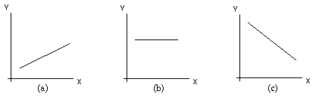
Remember Algebra 1?
X and Y are directly related (slope is positive)
X and Y are not related, or independent – for any value of X, Y is the same (slope is zero)
X and Y are inversely related (slope is negative)

Slide 3
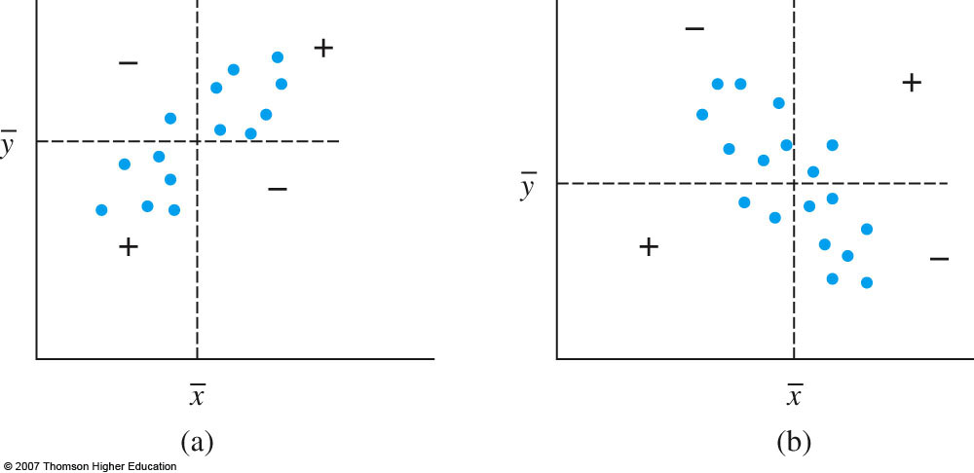
Variable Relationships
Assume we’re interested in seeing if two variables x and y are related.
Given n pairs of observations (x1, y1), (x2, y2), … , (xn,yn), x and y have a positive (direct) relationship if large x’s are paired up with large y’s and small x’s are paired up with small y’s; similarly, if large x’s are paired up with small y’s and small x’s are paired up with large y’s, then the relationship between x and y is negative (inverse).

Slide 4
Sample Correlation and Covariance
Covariance
A measure of how much two variables X and Y change together
The units of Cov (X, Y) are those of X multiplied by those of Y
Quite difficult to interpret
The covariance of a variable X with itself is simply the variance of X
Correlation
A standardized measure of the strength of the relationship between variables, known as correlation (r), is often used instead.
Value of r doesn’t depend on which variable is labeled x and which y
Value of r is independent of units of measurement of x and y
-1 ≤ r ≤ 1
r = 1 iff all (xi, yi) pairs lie on a straight line with positive slope and r=-1 iff all (xi, yi) pairs lie on a straight line with negative slope
r = 0 indicates a lack of a (linear) relationship between the variables

Slide 5
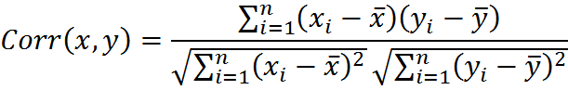
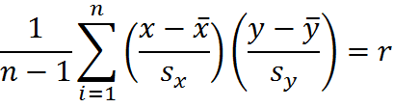
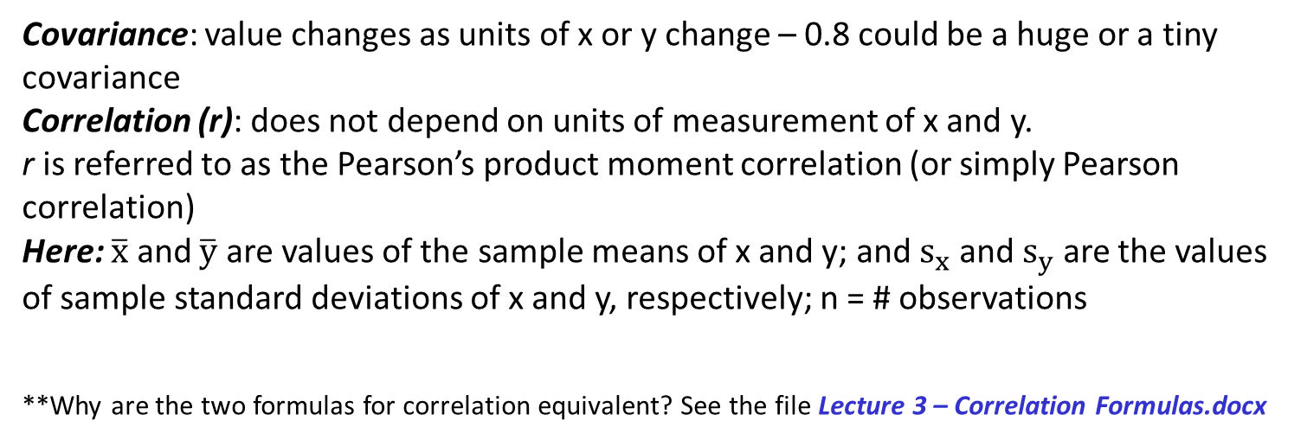
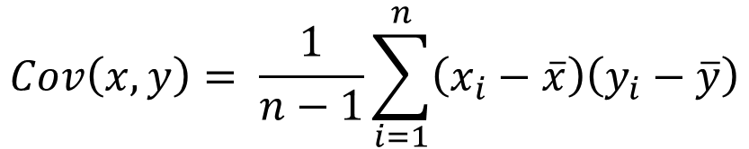
Sample Correlation and Covariance
$$Cov\left(x,y\right)= \frac{1}{n−1}\sum_{i=1}^{n}{\left(x_{i}−\overline{x}\right)\left(y_{i}−\overline{y}\right)}$$
=
i i
Covariance: value changes as units of x or y change – 0.8 could be a huge or a tiny covariance
Correlation (r): does not depend on units of measurement of x and y.
r is referred to as the Pearson’s product moment correlation (or simply Pearson correlation)
Here: $\overline{x}$ and $\overline{y}$ are values of the sample means of x and y; and $s_{x}$ and $s_{y}$ are the values of sample standard deviations of x and y, respectively; n = # observations
**Why are the two formulas for correlation equivalent? See the file Lecture 3 – Correlation Formulas.docx

Slide 6
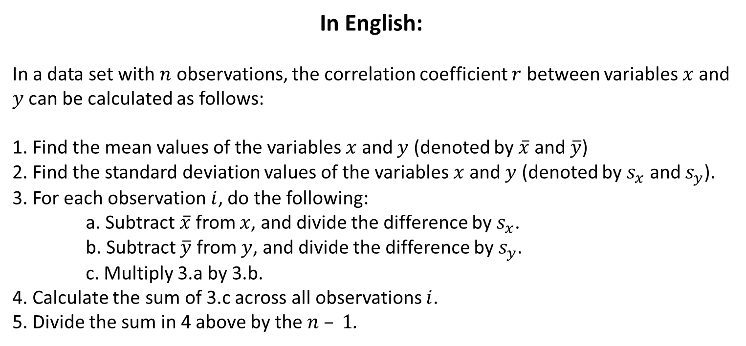
Sample Correlation Calculation
i i
In English:
In a data set with $n$ observations, the correlation coefficient $r$ between variables $x$ and $y$ can be calculated as follows:
1. Find the mean values of the variables $x$ and $y$ (denoted by $\overline{x}$ and $\overline{y}$)
2. Find the standard deviation values of the variables $x$ and $y$ (denoted by $s_{x}$ and $s_{y}$).
3. For each observation $i$, do the following:
a. Subtract $\overline{x}$ from $x$, and divide the difference by $s_{x}$.
b. Subtract $\overline{y}$ from $y$, and divide the difference by $s_{y}$.
c. Multiply 3.a by 3.b.
4. Calculate the sum of 3.c across all observations $i$.
5. Divide the sum in 4 above by the $n – 1$.

Slide 7
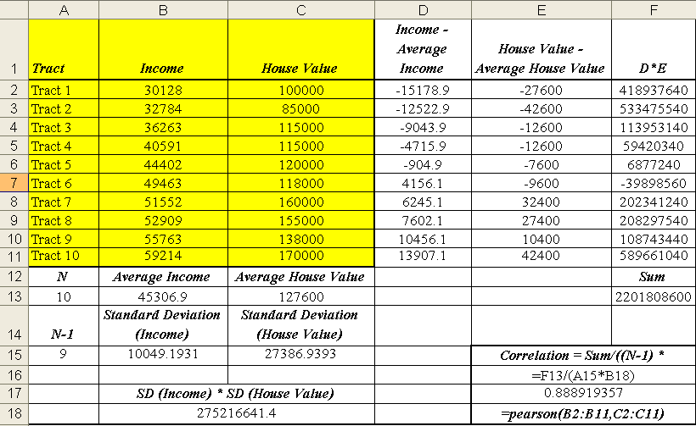
Example
Take a look at the file Lecture 3 – Correlations.xlsx for this example

Slide 8
Following the Steps on the Previous Slide…
Calculate Average Income across all tracts (Cell B13) and Average House Value (Cell C13) across all tracts.
For each tract,
Subtract the Average Income (B13) from the tract Income (column B). This difference can be found in column D.
Subtract the Average House Value (C13) from the tract House Value (column C). This difference can be found in column E.
Multiply the value in column D by the value in column E (product is in column F).
Add up the values in column F (the sum is in cell F13).
Calculate the standard deviation of Income (Cell B15) and the standard deviation of House Value (Cell C15).
Divide cell F15 by the product of B15, C15, and A15 (A15 is simply the number of observations minus 1).The result, in cell E17, is the correlation of income and house value. Note that the same value can be obtained with the formula in cell E18.

Slide 9
Positive Correlation – Example
As the values of one variable increase, so do the values of the other variable
E.g., there is a strong positive correlation between income and years of school.
Years of Schooling | Income (in $1,000)
8 | 20
9 | 21
10 | 25
11 | 27
12 | 30
13 | 38
14 | 40
15 | 41
16 | 50
17 | 60

Slide 10
Negative Correlation – Example
As values of one variable increase, the values of the other variable decrease.
For instance, in higher income neighborhoods, there tend to be lower rates of violent crime (e.g., # of robberies per 10,000 people)
Area | Income | Robberies per 10,000 people
A | $30,000 | 36
B | $40,000 | 33
C | $50,000 | 27
D | $60,000 | 25
E | $70,000 | 20
F | $80,000 | 18
G | $90,000 | 14
H | $100,000 | 15
Number of Robberies per 10,000 People vs. Income

Slide 11
Zero Correlation – Example
There is no (linear) relationship between two variables
E.g., median house value and average amount of rain (in inches) for a number of cities
City Name | House Value | Inches of Rain
A | 150000 | 30
B | 160000 | 25
C | 140000 | 27
D | 120000 | 21
E | 130000 | 17
F | 200000 | 17
G | 180000 | 28

Slide 12
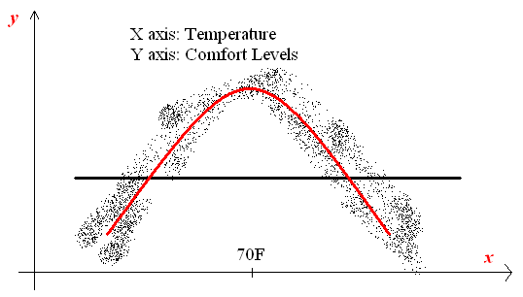
Zero Correlation: No Relationship?
It only means that there is no linear relationship between
the variables. Consider the following example:
There is a clear quadratic relationship here, even though the correlation coefficient would be zero.

Slide 13
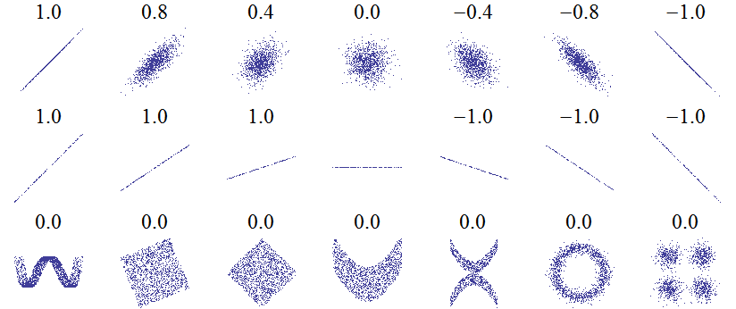
Scatterplots and Correlations
Source: http://upload.wikimedia.org/wikipedia/commons/0/02/Correlation_examples.png

Slide 14
Some Remarks
A correlation of a variable and itself is always 1.
In practice, we rarely see perfect positive or negative correlations (i.e., correlations of exactly 1 or -1)
What is a high correlation, what is a low correlation?
Depends on the field
Devore (p. 531) states the following rule of thumb:
0 ≤ |r| ≤ 0.5: weak correlation
0.8 ≤ |r| ≤ 1: strong correlation
Otherwise (between 0.5 and 0.8): moderate correlation
There might be confounding factors that explain a strong positive or negative correlation between variables
E.g., volume of ice cream consumption might be correlated with crime rates. Why?

Slide 15
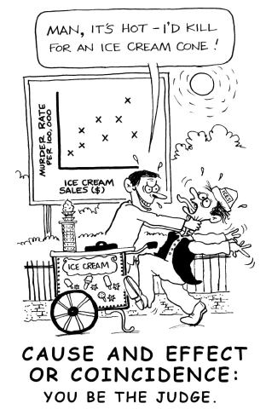
Ice Cream & Crime
Source: www.causeweb.org

Slide 16
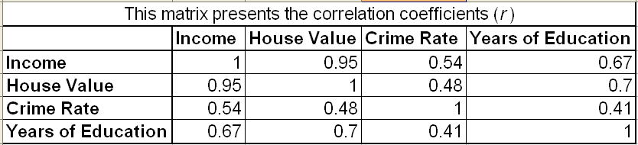
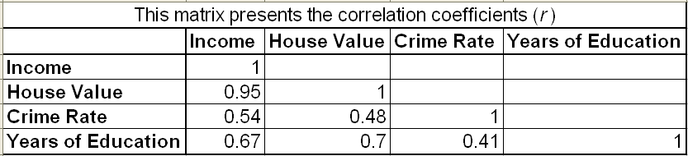
Correlation Matrix
Assume we have 4 variables (at the Census tract level): median house value, median household income, crime rate, median years of schooling.
A correlation matrix conveniently presents the pairwise correlations between variables.
From the matrix below, we can see that correlation between crime and education is 0.41.
Note that the matrix is symmetric around the main diagonal (that is, the correlation between crime and education is the same as the correlation between education and crime). Thus, it is common to present just the lower part of the matrix (as below).
Lower Full

Slide 17

Correlation Does Not Imply Causation!
Source: http://imgs.xkcd.com/comics/correlation.png

Slide 18
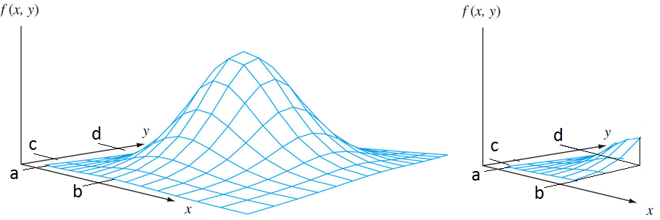
Pearson Correlation: Assumptions
Variables should be continuous (not categorical)
Linear relationship between variables
No vast outliers
The variables should have a bivariate normal distribution (BND)
BND looks like a bell. Volume under bell = 1
In the graph on the right, P(a ≤ X ≤ b, c ≤ Y ≤ d) = volume under the surface
In the graph on the left, we have the bivariate normal distribution
Parameters are μX, μY, σX, σY, ρ (population correlation coefficient)
www.aiaccess.net/English/Glossaries/GlosMod/e_gm_binormal_distri.htm
No entirely satisfactory way of testing for bivariate normality. One way to check is that X and Y should both be normal by themselves.
Notes:
http://www.aiaccess.net/English/Glossaries/GlosMod/e_gm_binormal_distri.htm

Slide 19
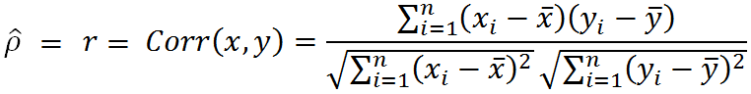
Sample vs. Population Correlation Coefficient
The sample correlation coefficient r is an estimator of the population correlation coefficient ρ (rho).
ρ becomes a measure of how strongly related X and Y are in that population.

Slide 20
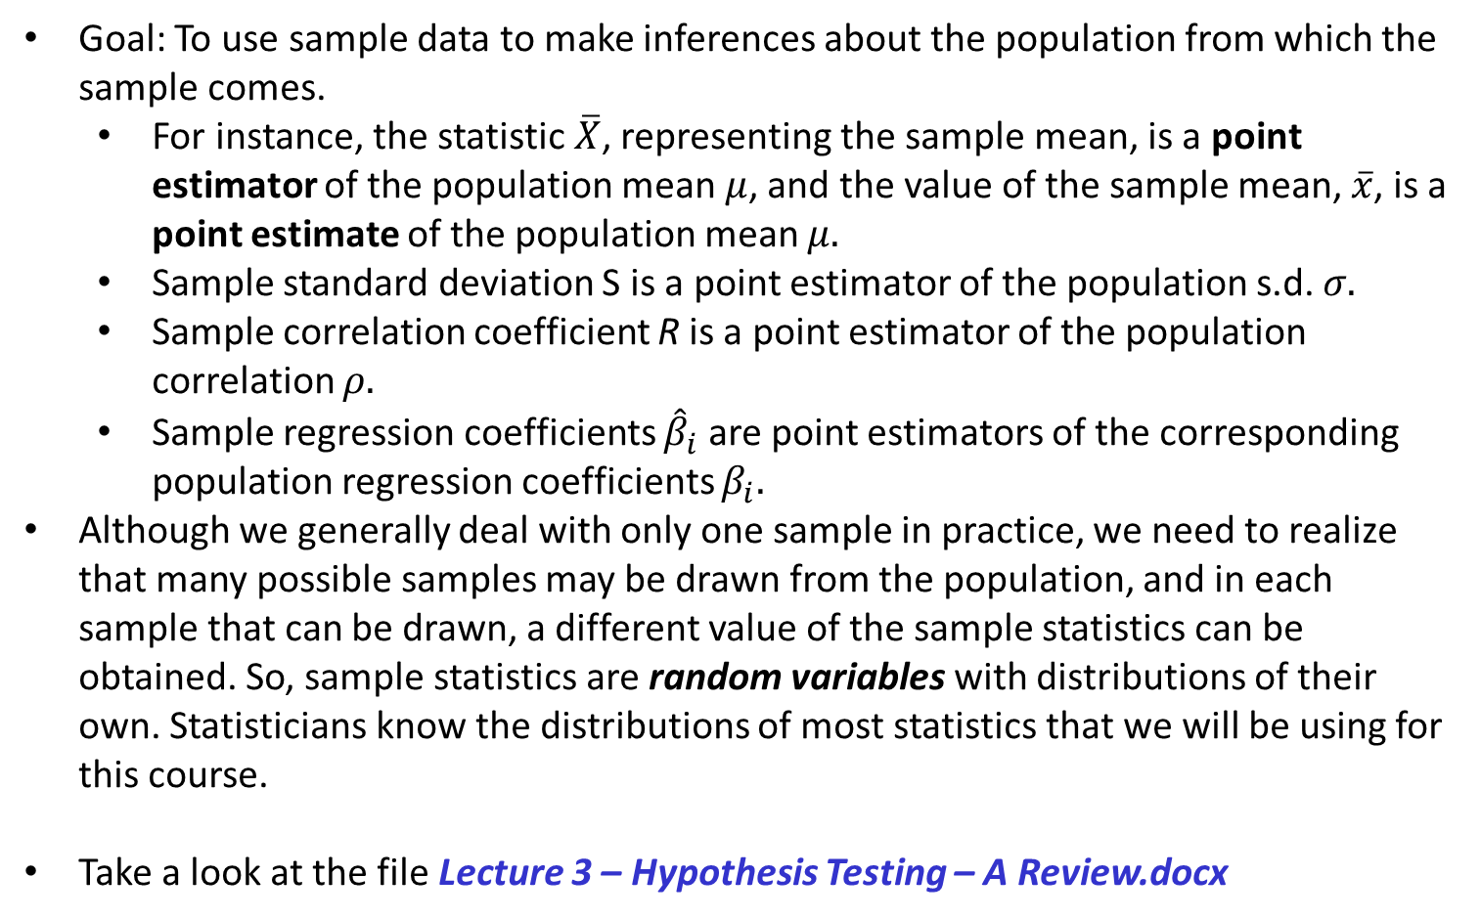
A Review of Hypothesis Testing
Goal: To use sample data to make inferences about the population from which the sample comes.
For instance, the statistic $\overline{X}$, representing the sample mean, is a point estimator of the population mean $μ$, and the value of the sample mean, $\overline{x}$, is a point estimate of the population mean $μ.$
Sample standard deviation S is a point estimator of the population s.d. $σ.$
Sample correlation coefficient R is a point estimator of the population correlation $ρ.$
Sample regression coefficients ${\hat{β}}_{i}$ are point estimators of the corresponding population regression coefficients $β_{i}.$
Although we generally deal with only one sample in practice, we need to realize that many possible samples may be drawn from the population, and in each sample that can be drawn, a different value of the sample statistics can be obtained. So, sample statistics are random variables with distributions of their own. Statisticians know the distributions of most statistics that we will be using for this course.
Take a look at the file Lecture 3 – Hypothesis Testing – A Review.docx

Slide 21
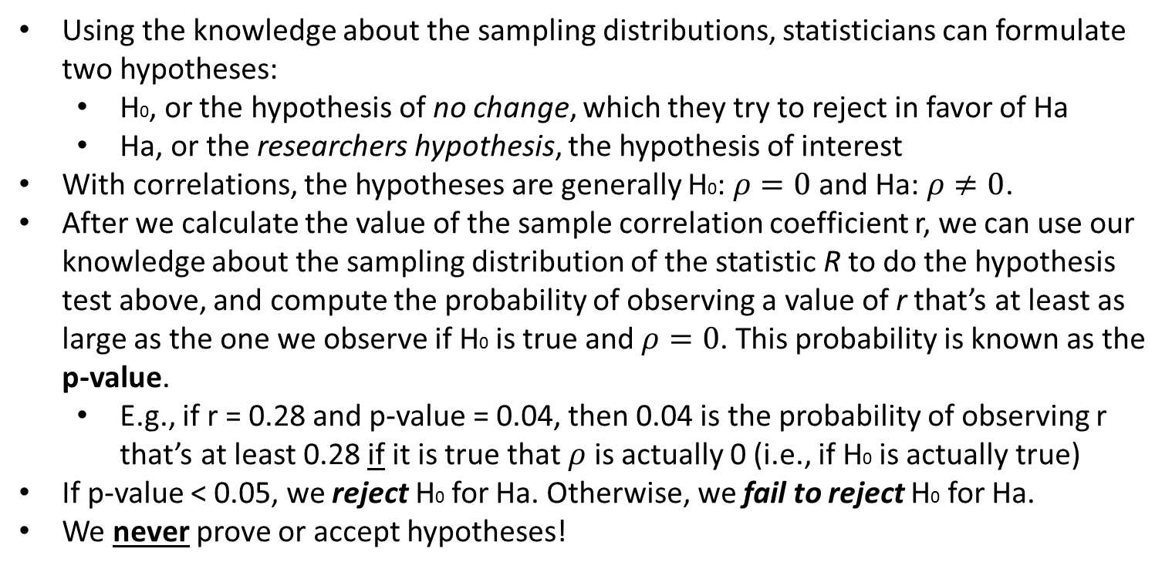
A Review of Hypothesis Testing (Cont’d)
Using the knowledge about the sampling distributions, statisticians can formulate two hypotheses:
H0, or the hypothesis of no change, which they try to reject in favor of Ha
Ha, or the researchers hypothesis, the hypothesis of interest
With correlations, the hypotheses are generally H0: $ρ=0$ and Ha: $ρ≠0$.
After we calculate the value of the sample correlation coefficient r, we can use our knowledge about the sampling distribution of the statistic R to do the hypothesis test above, and compute the probability of observing a value of r that’s at least as large as the one we observe if H0 is true and $ρ=0$. This probability is known as the p-value.
E.g., if r = 0.28 and p-value = 0.04, then 0.04 is the probability of observing r that’s at least 0.28 if it is true that $ρ$ is actually 0 (i.e., if H0 is actually true)
If p-value < 0.05, we reject H0 for Ha. Otherwise, we fail to reject H0 for Ha.
We never prove or accept hypotheses!

Slide 22
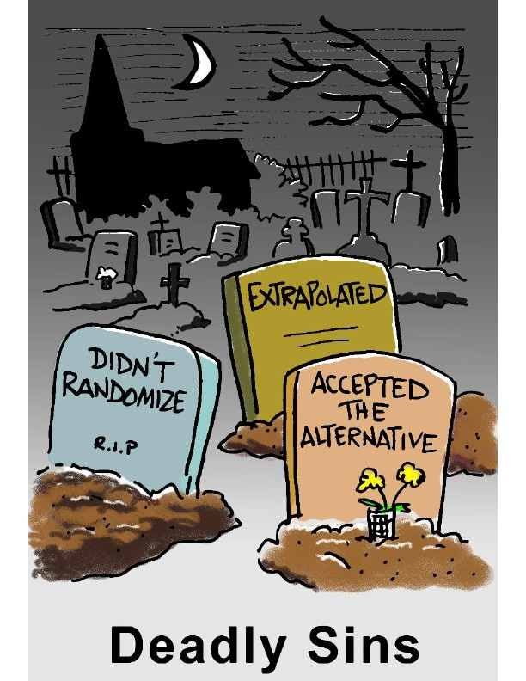
Source: www.causeweb.org

Slide 23
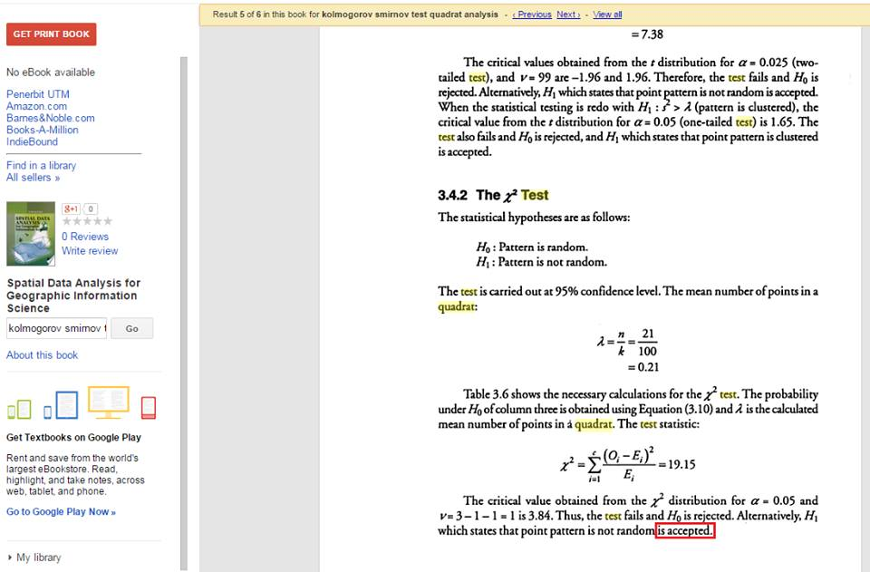
#FACEPALM

Slide 24
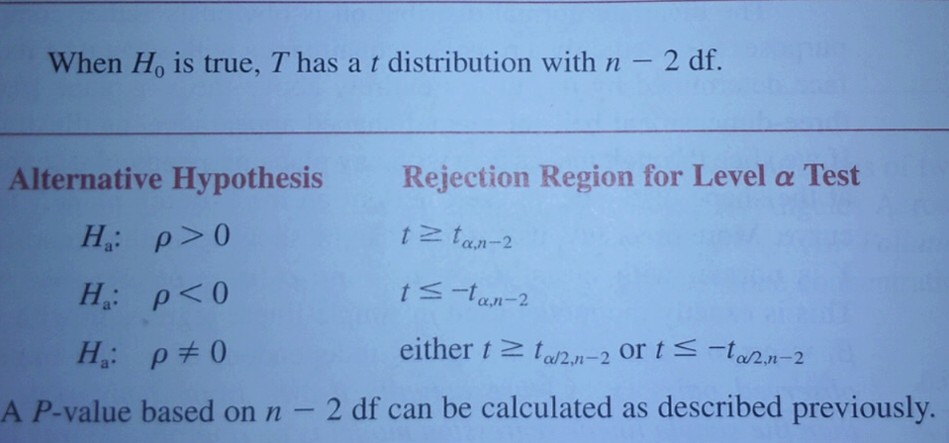
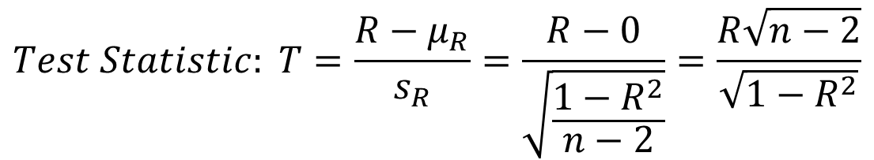
Procedure for Testing H0: ρ = 0
$$Test Statistic: T=\frac{R−μ_{R}}{s_{R}}=\frac{R−0}{\sqrt{\frac{1−R^{2}}{n−2}}}=\frac{R\sqrt{n−2}}{\sqrt{1−R^{2}}}$$

Slide 25
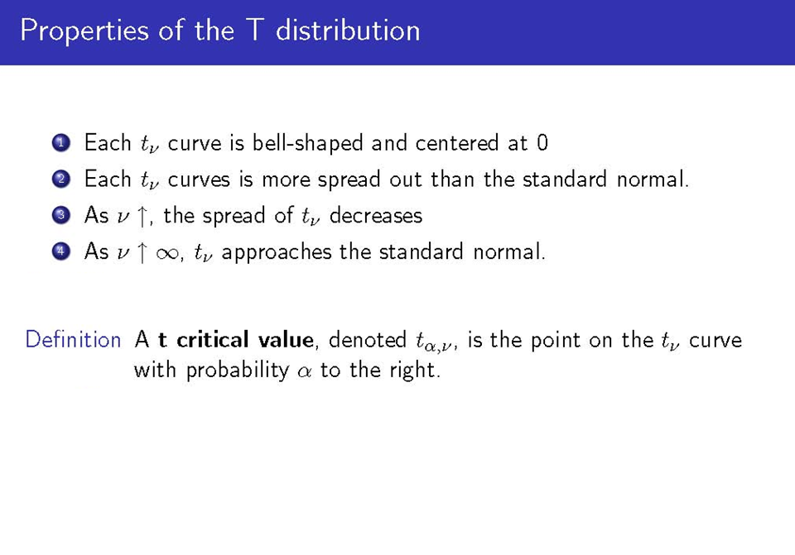
T- Distribution has two parameters: α, and degrees of freedom ν
Critical values for selected ν and α can be found at:
http://easycalculation.com/statistics/t-distribution-critical-value-table.php

Slide 26
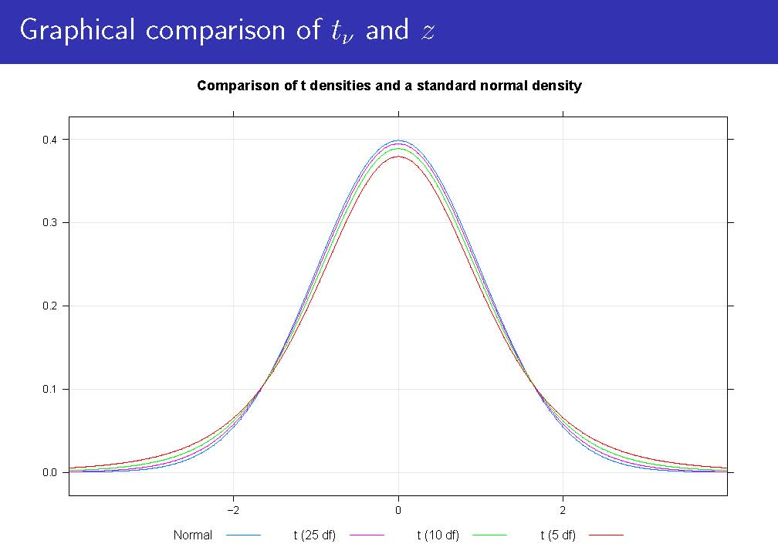

Slide 27

Source: www.causeweb.org

Slide 28
Degrees of Freedom
Degrees of freedom of an estimate is the number of independent pieces of information that went into calculating the estimate (or alternatively, the number of independent values that a statistical analysis can estimate). It’s related to the number of observations in the sample.
One way to look at degrees of freedom is that they are the number of values that are free to vary in a data set. What does “free to vary” mean? Here’s an example using the mean (average): Q. Pick a set of numbers that have a mean (average) of 10. A. Some sets of numbers you might pick: 9, 10, 11 or 8, 10, 12 or 5, 10, 15. Once you have chosen the first two numbers in the set, the third is fixed. In other words, you can’t choose the third item in the set. The only numbers that are free to vary are the first two. You can pick 9 + 10 or 5 + 15, but once you’ve made that decision you must choose a particular number that will give you the mean you are looking for. So degrees of freedom for a set of three numbers is TWO.
For our intents of purposes, degrees of freedom is just a parameter of the t (and some other) distributions
Taken verbatim from: https://www.statisticshowto.com/probability-and-statistics/hypothesis-testing/degrees-of-freedom/ Also look at: https://statisticsbyjim.com/hypothesis-testing/degrees-freedom-statistics/

Slide 29
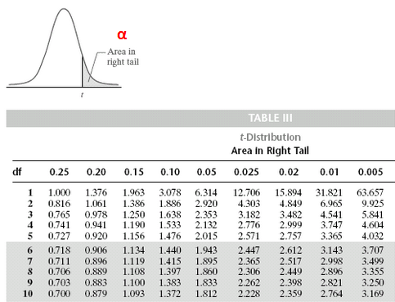
Illustration
For instance, the critical value of t is 1.812 when alpha is 0.05 and df=10.

Slide 30
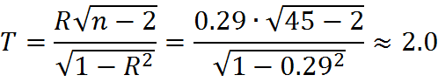
Example
Assume that we have a sample of 45 zip codes. For each one of the zip codes, we have two variables: median household income (x) and median number of children (y). The correlation r between the x and y is 0.29. We want to test the hypothesis H0: ρ = 0 vs. Ha: ρ ≠ 0, at significance level 0.05. For the sake of example, assume that the random variables X and Y are from a bivariate normal distribution.
Plugging in r=0.29 and n=45 into formula on previous slide, we get:
The corresponding p-value for a t-test based on 43 df is roughly 0.052 (type in =TDIST(2,43,2) in Excel). We would not want to reject the assertion that H0 is 0 at significance level 0.05, since p=0.052 is slightly greater than α=0.05. That is, there is not sufficient evidence that there is a significant linear relationship between median income and median number of children across all households in the population.
If the true population correlation coefficient is 0, then is not that unlikely to observe a sample correlation coefficient of 0.29 simply due to sampling variability

Slide 31
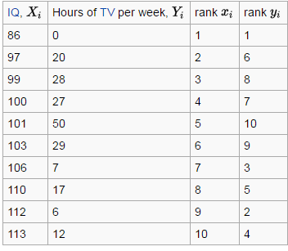
Spearman Correlation Coefficient
When the assumptions of bivariate normality clearly do not hold, we may want to assess the relationship between two variables (which may be continuous or ordinal) using a non-parametric method called Spearman Correlation.
The Spearman correlation coefficient is simply the Pearson correlation of the rank variables that are calculated from the original variables.
Example: Imagine we have two variables, IQ (X) and Hours of TV per week (Y)
For each observation, we can calculate the rank of x and the rank of y
There are ways to deal with tied ranks
Significance tests exist as well
Table Source: https://en.wikipedia.org/wiki/Spearman%27s_rank_correlation_coefficient

Slide 32
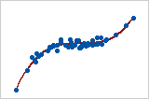
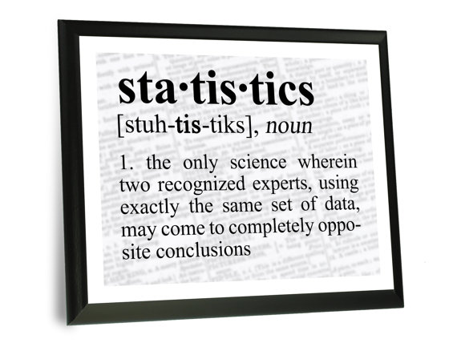
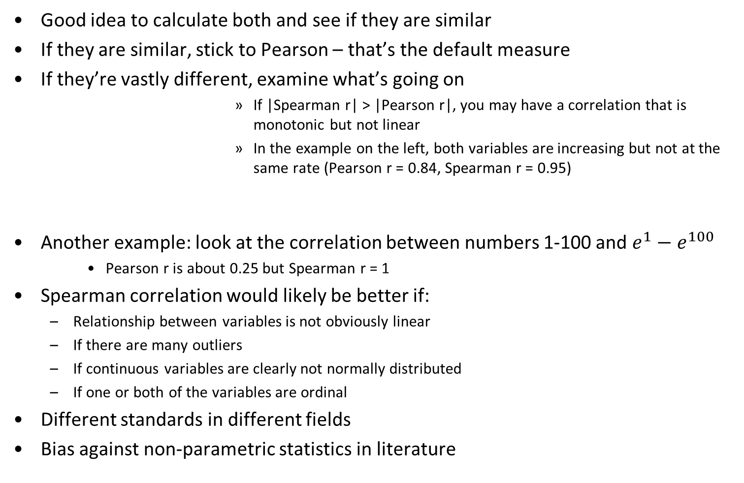
Choosing between Pearson & Spearman
Good idea to calculate both and see if they are similar
If they are similar, stick to Pearson – that’s the default measure
If they’re vastly different, examine what’s going on
If |Spearman r| > |Pearson r|, you may have a correlation that is monotonic but not linear
In the example on the left, both variables are increasing but not at the same rate (Pearson r = 0.84, Spearman r = 0.95)
Another example: look at the correlation between numbers 1-100 and $e^{1}−e^{100}$
Pearson r is about 0.25 but Spearman r = 1
Spearman correlation would likely be better if:
Relationship between variables is not obviously linear
If there are many outliers
If continuous variables are clearly not normally distributed
If one or both of the variables are ordinal
Different standards in different fields
Bias against non-parametric statistics in literature
Source: http://tinyurl.com/gw8taby
Source: https://img1.etsystatic.com/066/0/7847606/il_570xN.770530683_g2rg.jpg

Slide 33
In R
setwd("C:/Users/eugeneby/Dropbox/Documents/Work and School/Teaching/CPLN 671/Data/Lecture 3 - R")
mydata <- read.csv("Pearson_Spearman_Correlations.csv")
options(scipen = 999) #Avoid getting results in scientific notation!!!
head(mydata) # View the first few rows of the data
summary(mydata) # Summarize each variable
cor(mydata$X, mydata$Y, method="pearson") # Method can be pearson or spearman
cor(mydata$RankX, mydata$rankY, method="pearson") #What’s wrong with this code?
cor(mydata$X, mydata$Y, method="spearman") #Alternatively, do the following
cor(mydata) #Correlation matrix for all variables in the data set mydata
#Is the correlation between X and Y significant?
#Pearson: p-value is 0.01142 - since it's significantly lower than 0.05, we reject the null hypothesis that rho = 0
cor.test(mydata$X, mydata$Y, method=("pearson"))
#Spearman: p-value is infinitesimally small, so we reject the null hypothesis that rho = 0.
cor.test(mydata$X, mydata$Y, method=("spearman"))

Slide 34
A Review of Correlations
See file Lecture 4 – Reviewing Correlations.docx for a detailed summary

Slide 35
OLS Regression
A statistical method used to examine the relationship between a variable of interest (dependent variable) and one or more explanatory variables (predictors)
Strength of the relationship
Direction of the relationship (positive, negative, zero)
Goodness of model fit
Allows you to calculate the amount by which your dependent variable changes when a predictor variable changes by one unit (holding all other predictors constant)
Often referred to as Ordinary Least Squares (OLS) regression
Regression with one predictor is called simple regression
Regression with two+ predictors is called multiple regression
Available in all statistical packages
Just like correlation, if an explanatory variable is a significant predictor of the dependent variable, it doesn’t imply that the explanatory variable is a cause of the dependent variable

Slide 36
Variable Relationships
Two variables, x and y, can be related to each other in two ways:
In a Deterministic Way – i.e., y is some mathematical function of x (e.g., y=log(x+8); y=x²; y=4x+8; etc.) and if we know x, we can calculate y.
E.g., person’s height in centimeters (x) and in meters (y)
In a Non-Deterministic Way – i.e., there is some general relationship between x and y, but no formula that will enable you to calculate the precise value of y for x.
E.g., SAT scores and college GPA (positive relationship);
Crime Rate and Household Income (negative relationship);
Temperature in room and comfort level (seemingly quadratic relationship)

Slide 37
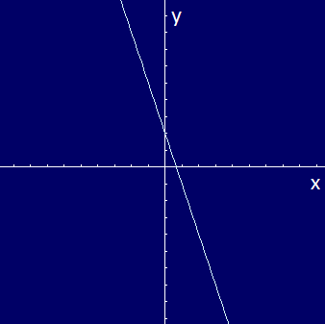
The Simplest Deterministic Relationship
The simplest deterministic mathematical relationship between two variables x and y is a linear relationship y=mx+b, which statisticians write as y = β0 + β1x.
The set of pairs (x,y) for which y = β0 + β1x determines a straight line with slope β1 and y-intercept β0.
The slope of a line is the change in y for a 1-unit increase in x. For example, if y = -3x + 2, then y decreases by 3 when x increases by 1, so the slope is -3. The y-intercept (2) is the height at which the line crosses the vertical y-axis and is obtained by setting x=0 in the equation.
x | y
-4 | 14
-3 | 11
-2 | 8
-1 | 5
0 | 2
1 | -1
2 | -4

Slide 38
Non-Deterministic Relationship
If two variables are not deterministically related, then for a fixed value of x the value of the second variable is random.
If we’re investigating the relationship between age of a child and size of vocabulary and decide to select a child of age x=5.0 years, then before the selection is made, vocabulary size is a random variable, Y.
After a particular 5 year old has been selected and tested, a vocabulary of y=2000 words may result.
The observed value of Y associated with fixing x=5.0 was y=2000.
The variable whose value is fixed by the experimenter will be denoted x (age in the example above), and is called
The independent variable, or
The explanatory variable, or
The predictor
For fixed values of x, the second variable will be random. The variable will be denoted by Y and its values will be denoted by y. It is called
The dependent variable, or
The response variable (psychology/data mining lingo)
The target variable (data mining lingo)

Slide 39
Example
Think of a bivariate (two-variable) dataset with n pairs (x1, y1), (x2,y2),…,(xn,yn)
Below, you we have a sample dataset where n=10. The relationship between the dependent variable (vocabulary size) and the predictor variable (age) is graphed on the scatter plot on the right.
Person # | Age of Child | Vocabulary
i | xi | yi
1 | 8 | 2800
2 | 3 | 800
3 | 4 | 1200
4 | 5 | 1700
5 | 6 | 1600
6 | 6 | 1800
7 | 2 | 300
8 | 7 | 2200
9 | 4 | 1300
10 | 5 | 1600
Note that there are observations with identical x values yet different y values
There’s a strong tendency for y to increase as x increases

Slide 40
Example (Cont’d)
It appears that the value of y could be predicted from x by finding a line that is reasonably close to the points in the plot. In other words, there is evidence of a substantial, though not perfect, linear relationship between x and y. When this is the case, we may use the methods we’re about to present.

Slide 41
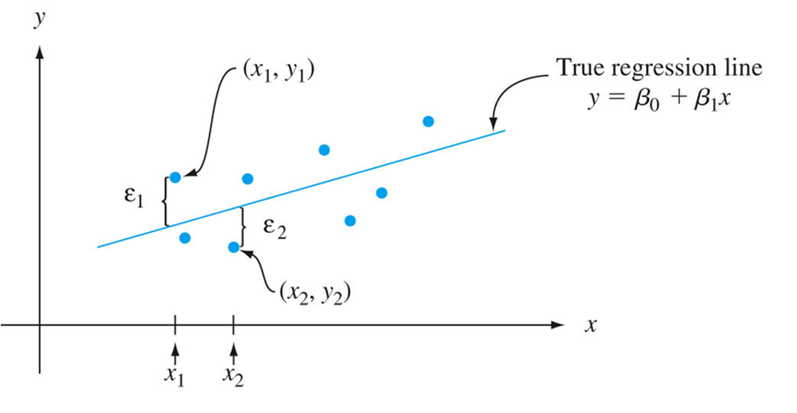
A Linear Probabilistic Model
Recall: For the deterministic model y = β0 + β1x, the actual observed value of y is a linear function of x
In a probabilistic model, we assume that the expected value of Y is a linear function of x, but for fixed x, the variable Y differs from its expected value by a random amount ε

Slide 42
The Residual Term ε
The variable ε is usually referred to as the residual or random error term in the model.
Without ε, any observed pair (x,y) would fall exactly on the line y = β0 + β1x, called the true (or population) regression line.
The inclusion of the random error term ε allows (x,y) to fall either above the true regression line (when ε > 0), or below the line (when ε <0)
The points (x1, y1), (x2,y2),…,(xn,yn) resulting from n independent observations will then be scattered about the true regression line

Slide 43
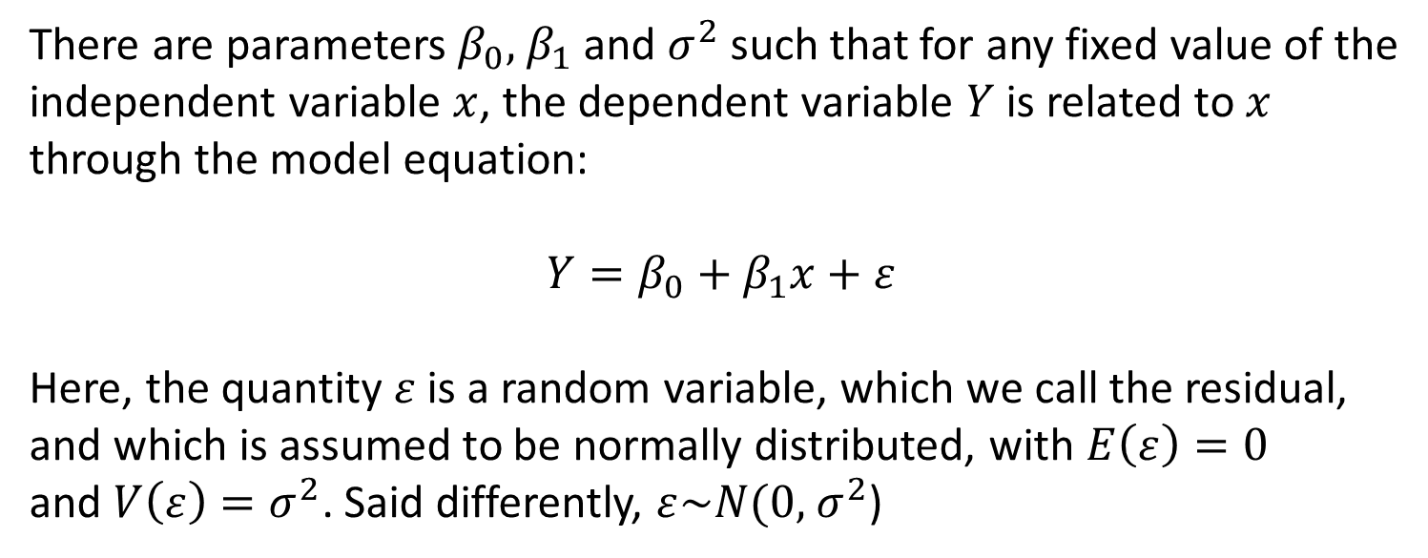
The Simple Linear Regression Model
There are parameters $β_{0},$ $β_{1}$ and $σ^{2}$ such that for any fixed value of the
independent variable $x$, the dependent variable $Y$is related to $x$
through the model equation:
$$Y=β_{0}+β_{1}x+ε$$
Here, the quantity $ε$ is a random variable, which we call the residual,
and which is assumed to be normally distributed, with $E\left(ε\right)=0$
and $V\left(ε\right)=σ^{2}$. Said differently, $ε\sim N(0,$ $σ^{2}$)

Slide 44
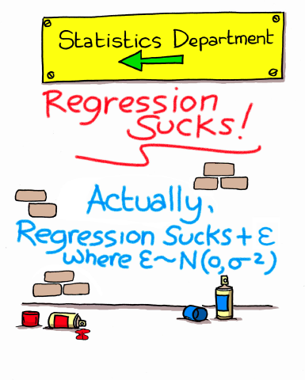
The Simple Linear Regression Model
Source: www.causeweb.org

Slide 45
Optional: Some Notation…
Implications of the equation y = β0 + β1x + ε can best be understood with the aid of the following notation.
Let x* denote a particular value of the independent variable X. Then:
μY∙x* = E(Y|x*) = the expected (mean) value of Y when X=x*
σ²Y∙x* = V(Y|x*) = variance of Y when X=x*
If we think of an entire population of (x,y) pairs, then μY∙x* is the mean of all y values for which X=x*, and σ²Y∙x* is a measure of how much these values of y are spread out about the mean value
Old Example: μY∙5 is the expected value of vocabulary size when x*=5 (i.e., when the child is 5 years old), and σ²Y∙5 is the variability in (variance of) vocabulary size for 5 year olds.
Once x is fixed, the only randomness on the right-hand side of the model equation y = β0 + β1x + ε is in the random error ε, which has mean 0 and variance σ², respectively, regardless of what the value of x is.
This implies that:
μY∙x* = E(β0 + β1x* + ε) = β0 + β1x* + E(ε) = β0 + β1x* + 0 = β0 + β1x*
σ²Y∙x* = V(β0 + β1x* + ε) = β0 + β1x* + V(ε) = 0 + 0 + σ² = σ²
Replacing x* in μY∙x* by x, we get μY∙x = β0 + β1x.

Slide 46
Implications of the Simple Regression Model
The mean value of Y is a linear function of x.
That is, the true regression line y = β0 + β1x is the line of mean values.
Y-value on the line at any x is the expected value of Y at that x.
The slope β1 is then the expected (average) change in Y associated with a 1-unit increase in the value of x.
The amount of variability in the distribution of Y values is the same at each value of x.

Slide 47
Example
Recall the age and vocabulary size example. The model implies:
Average vocabulary size changes linearly with age
Hopefully, β1 is positive
β1 is the (expected) change in vocabulary size (Y) when the value of age (x) goes up by 1 unit (i.e., 1 year)
The amount of variability in vocabulary size at any particular age is the same as at any other age. That is, the variance in the vocabulary of 3 year olds is the same as the variance in the vocabulary of 5 year olds.
For any fixed x (age), vocabulary size (Y) is the sum of a constant term (β0 + β1x) and a normally distributed rv ε

Slide 48
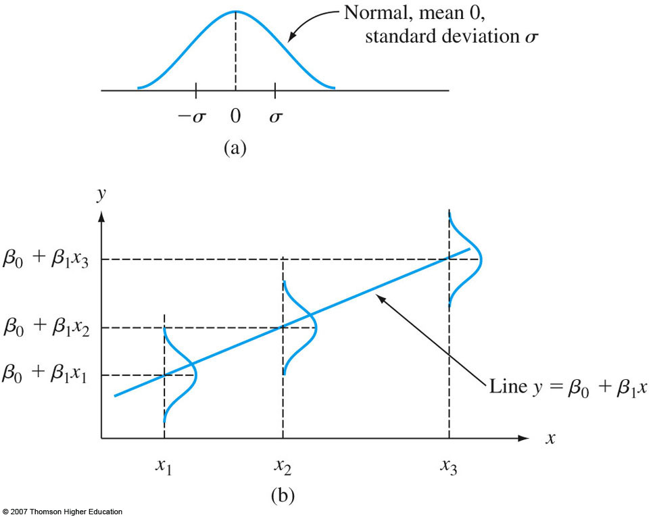
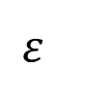
$$ε$$
The variance parameter σ² determines the extent to which each normal curve spreads about its mean value (height of the line)

Slide 49
Example
Another Example
Suppose the relationship between two variables Y (house price in the 1970’s) and X (number of vacant houses in a quarter mile radius) is described by the simple linear regression model with true regression line Y = 65 – 1.2X. Assume further that ε~N(0, 64), so σ² = 64 and σ = 8, meaning that the magnitude of a typical deviation from the true regression line is about 8 units.
For x=20, Y has mean value of μY∙20 = 65 – 1.2 * 20 = 41. Similarly, for x=25, Y has mean value of μY∙25 = 65 – 1.2 * 25 = 35.
For example, we can calculate P(Y>50) when x=20 and 25 by standardizing Y, as done on the next slide.

Slide 50
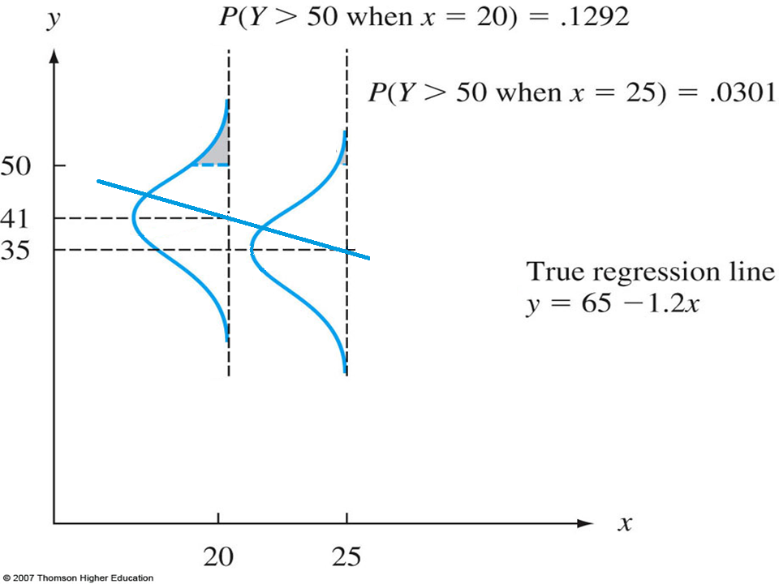
$$P\left(Y>50 when x=20\right)=P\left(Z>\frac{50−41}{8}=1.13\right)=1−Φ\left(1.13\right)=0.1292$$
$$P\left(Y>50 when x=20\right)=P\left(Z>\frac{50−35}{8}=1.88\right)=1−Φ\left(1.88\right)=0.0301$$

Slide 51
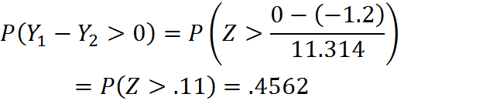
Example (Cont’d)
From the previous example, suppose that Y1 is the value when x=25 and Y2 is the value when x=24. Then if Y1-Y2 is also normal with mean value E(Y1-Y2) = β1 = -1.2, the variance is V(Y1 – Y2) = σ² + σ² = 64 + 64 = 128, and standard deviation = √128 = 11.314. Then the probability that Y1 > Y2 is:
So, even though we expected Y to decrease when x increases by 1 unit, it is not that unlikely that the observed Y at x + 1 will be larger than the observed Y at x.

Slide 52
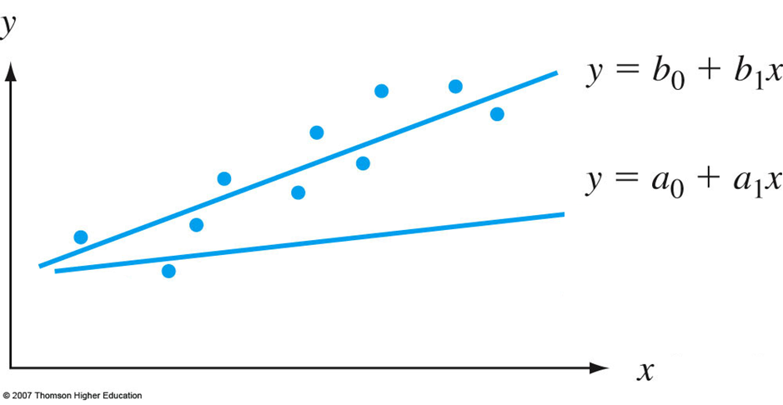
Parameter Estimation
How do we get appropriate parameter estimates β0 and β1?

Slide 53
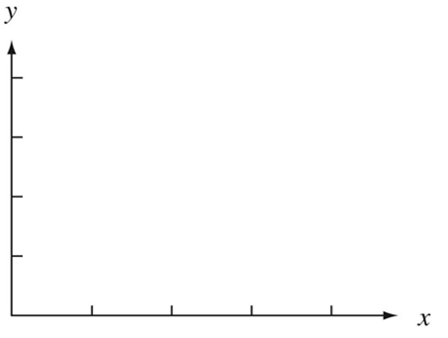
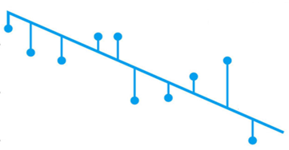
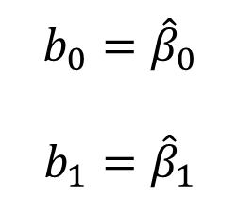
Least Squares Estimation
The way calculate values for β1 and β0 involves minimizing the sum of squared vertical distances (i.e., residuals) between the points and the (estimated) regression line. This way of obtaining parameters is called the least squares principle.
$$b_{0}={\hat{β}}_{0}$$
$$b_{1}={\hat{β}}_{1}$$

Slide 54
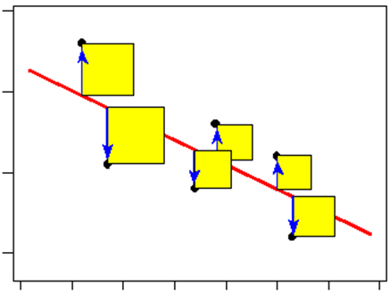
Geometric Interpretation of Least Squares
Minimize the total area of these squares (where the side of each square is the residual)
Source: http://bolt.mph.ufl.edu/files/2012/07/images-mod2-linear12.gif

Slide 55
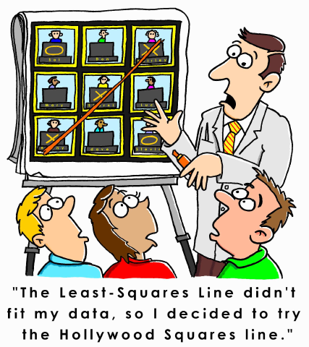
Least Squares Estimation
Source: www.causeweb.org

Slide 56
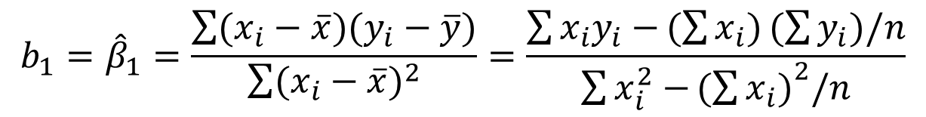
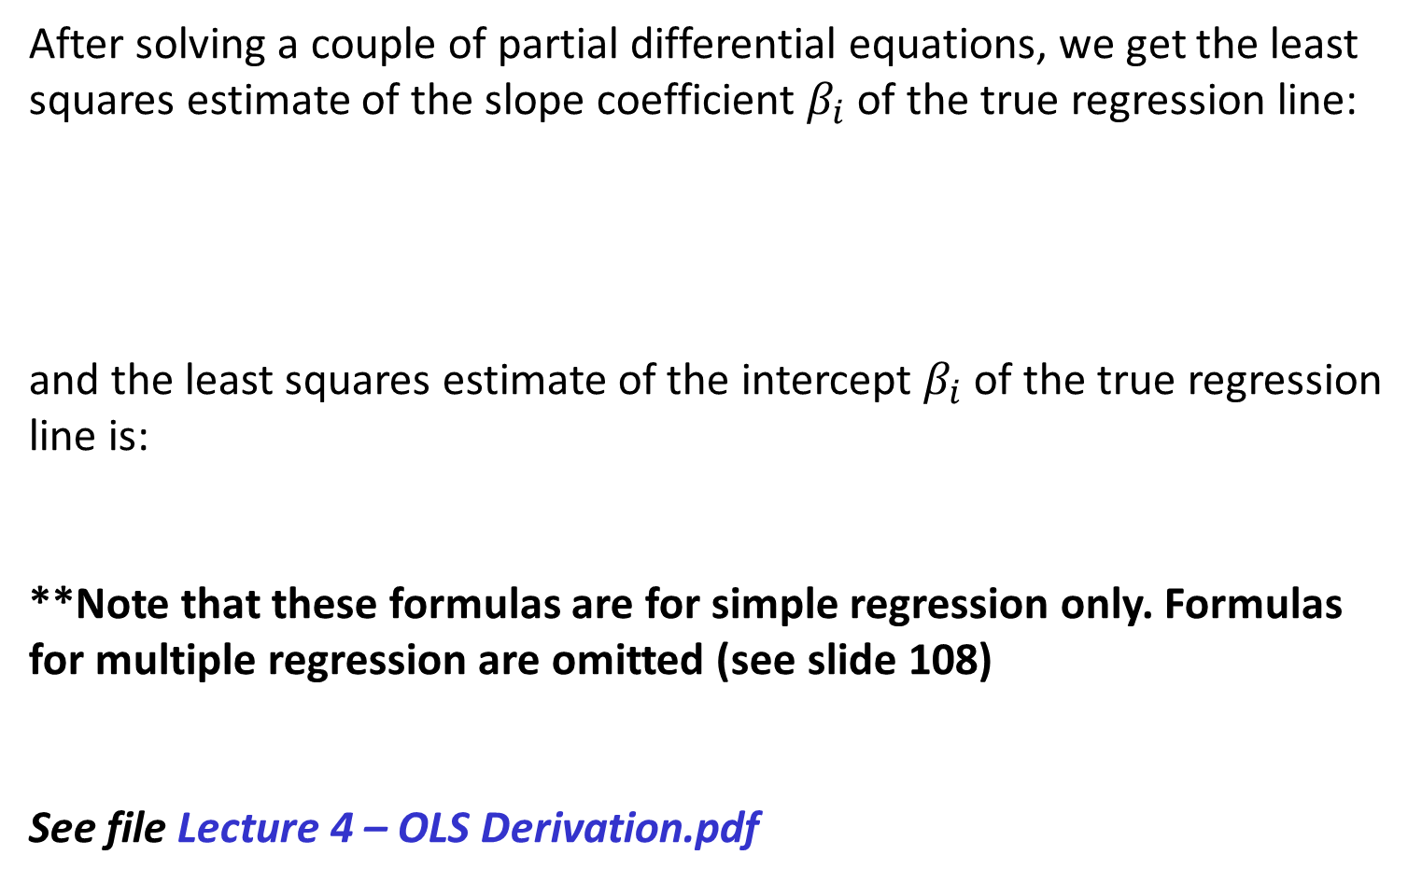
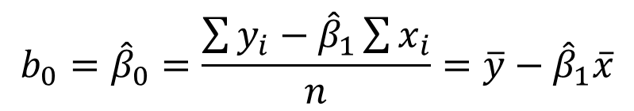
Least Squares Estimation (Cont’d)
After solving a couple of partial differential equations, we get the least squares estimate of the slope coefficient $β_{i}$ of the true regression line:
and the least squares estimate of the intercept $β_{i}$ of the true regression line is:
**Note that these formulas are for simple regression only. Formulas for multiple regression are omitted (see slide 108)
See file Lecture 4 – OLS Derivation.pdf
$$b_{1}={\hat{β}}_{1}=\frac{\sum{(x_{i}−\overline{x})(y_{i}−\overline{y})}}{\sum{{(x_{i}−\overline{x})}^{2}}}=\frac{\sum{x_{i}y_{i}−}(\sum{x_{i})}(\sum{y_{i})/n}}{\sum{x_{i}^{2}−}{(\sum{x_{i})}}^{2}/n}$$
$$b_{0}={\hat{β}}_{0}=\frac{\sum{y_{i}−{\hat{β}}_{1}}\sum{x_{i}}}{n}=\overline{y}−{\hat{β}}_{1}\overline{x}$$

Slide 57
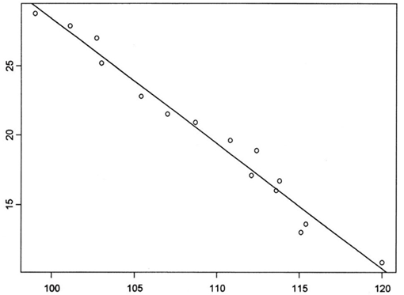
Example
Assume that we want to study how the number of shoplifting incidents in a region is associated with annual rents for Wawa stores. In the scatter plot below, we see that in our sample of n=15 Wawa stores, y=annual rent (measured in $1000) is linearly related to x=number of shoplifting incidents in the immediate area. The data are presented on the next slide.
Annual Rent for Store (in $1000)
# of shoplifting incidents in all businesses in the area

Slide 58
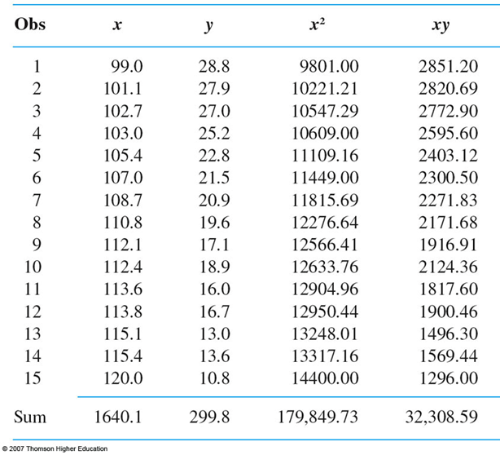
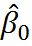
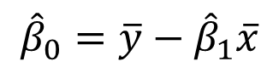

Plug in values into formulas to solve for
and
We get:
= -0.905
=118.91
$${\hat{β}}_{1}=\frac{\sum{x_{i}y_{i}−}(\sum{x_{i})}(\sum{y_{i})/n}}{\sum{x_{i}^{2}−}{(\sum{x_{i})}}^{2}/n}$$
$${\hat{β}}_{0}=\overline{y}−{\hat{β}}_{1}\overline{x}$$
For a detailed demonstration, see file Lecture 4 – Estimation of Beta Coefficients.docx

Slide 59

Interpretation
= -.905
= 118.91
So, the expected change in annual store rent associated with 1 additional shoplifting incident in the area is -.905*($1000) = -$905. Said differently, 1 additional shoplifting incident in the area is associated with a $905 decrease in annual store rent.
A point estimate for true average annual rent for all stores located in an area with 110 shoplifting incidents is:

Slide 60

Estimating σ²
The parameter σ² determines the amount of variability inherent in the regression model.
If σ² is small, then the pairs (xi, yi) are going to fall very close to the true line (graph a)
If σ² is large, then the pairs (xi, yi) are going to be quite spread out about the true regression line (graph b)

Slide 61




Estimating σ²
The fitted (or predicted) values ŷ1, ŷ2 ,…, ŷn are obtained by substituting x1,…,xn into the equation of the estimated regression line, so:
The residuals are vertical deviations
$$ε_{1}=y_{1}−{\hat{y}}_{1}$$
$$ε_{2}=y_{2}−{\hat{y}}_{2}$$
$$ε_{n}=y_{n}−{\hat{y}}_{n}$$
from the estimated line.

Slide 62

Estimating σ² (Cont’d)
Note: This is the SSE formula for simple regression. Formula for SSE in multiple regression can be found on a later slide.
NB: SSE is the quantity that the Least Squares attempts to minimize

Slide 63






Estimating σ²
Assume we’re trying to regress variable y on x. Let x be traffic flow (thousands of cars per 24 hours). Let y be the lead content of bark on trees near the highway (g). Assume we have 11 observations as below.
Notes:
More cars – more exhaust gases – more lead on bark of trees.

Slide 64
Example (Cont’d)
Here, SSE = (-60.48)² + (24.52)² + (-62.98)² + … + (60.06)² = 76,493.98.
Also, s², estimate of σ², = 76,493.98/(11-2)=8499.33, and s = S.D. = √8499.33 = 92.19 = magnitude of a typical deviation from reg. line.

Slide 65

Amount of Variation Explained by Model
All of the variation in y is explained by predictor x.
Most of the variation in y is explained by predictor x.
Little of the variation in y is explained by predictor x.

Slide 66

SST
In the previous slide, there is no unexplained variation in scatterplot (a), whereas unexplained variation is present in scatterplot (b) and much more of it is present in scatterplot (c).
A quantitative measure of the total amount of variation in observed y values is given by the total sum of squares (SST):
The SST is the sum of squared deviations about the sample mean of the observed y values – without regard to x.

Slide 67


SSE vs. SST
The SSE and SST formulas are below:
The SSE involves subtracting ŷ, the predicted value of y, from each yi, and then squaring each difference and summing all the differences. SSE depends on β’s (i.e., in a linear model with non-zero slope, ŷ will be different for different levels of x).
The SST involves subtracting y̅, the mean value of y, from each yi, and then squaring each difference and summing all the differences.
SSE SST
Notes:
If there is no relationship between x and y, the best fitting line will be flat, and the expected value of Y given x will remain the same, best estimated by y-bar, regardless of the value of x.

Slide 68
The Coefficient of Determination
If SSE is the amount of variance in y unexplained by the regression model and SST is the total amount of variance in y, then SSE/SST is the proportion of total variance that is unexplained by the model.
Then 1 – SSE/SST = SSR/SST = R², called the coefficient of determination, is the proportion of observed variation in the dependent variable y that was explained by the model. Here, SSR is the regression sum of squares, and is calculated as SSR = SST – SSE.
The higher the value of R², the more successful is the simple linear regression model in explaining the variation in the dependent variable y. If R² is small, then you will usually want to look for another model, which either includes alternative, additional, or transformed predictors (more on additional and transformed predictors later).
N.B.: R² is the square of r, the correlation coefficient we saw earlier!

Slide 69
SSE, SSR and SST – Acronym Fiasco
SSE
What we call it | SSE | Sum of squared errors
Other names | SSR | Sum of squared residuals
 | ESS | Error sum of squares
 | RSS | Residual sum of squares
SST
What we call it | SST | Total sum of squares
SSM
What we call it | SSR | Regression sum of squares
Other names | RSS | Regression sum of squares
 | SSM | Model sum of squares
See files:
Lecture 5 – SSE vs. SST.docx
Lecture 5 – A Detailed Regression Example.docx

Slide 70




Inferences About the Slope Parameter β1
The slope β1 of the population regression line is the true average change in the dependent variable y associated with a 1-unit increase in the predictor x.
Calculated from sample data, the slope of the least squares regression line, ${\hat{β}}_{1}$, gives a point estimate of β1.
Because ${\hat{β}}_{1}$ varies from sample to sample, it is a random variable.
${\hat{β}}_{1}$has a sampling distribution with mean $E\left({\hat{β}}_{1}\right)$ and variance $Var\left({\hat{β}}_{1}\right)$.
$$E\left({\hat{β}}_{1}\right)=β_{1}, just like E\left(\overline{X}\right)=μ$$
$$Var\left({\hat{β}}_{1}\right)=\frac{\frac{SSE}{n−2}}{\sum_{i=1}^{n}{{\left(x_{i}−\overline{x}\right)}^{2}}}=\frac{{\hat{σ}}_{ε}^{2}}{\sum_{i=1}^{n}{{\left(x_{i}−\overline{x}\right)}^{2}}}$$
$$SD\left({\hat{β}}_{1}\right)=\sqrt{\frac{\frac{SSE}{n−2}}{\sum_{i=1}^{n}{{\left(x_{i}−\overline{x}\right)}^{2}}}}=\frac{{\hat{σ}}_{ε}}{\sqrt{\sum_{i=1}^{n}{{\left(x_{i}−\overline{x}\right)}^{2}}}}=\frac{s}{\sqrt{\sum_{i=1}^{n}{{\left(x_{i}−\overline{x}\right)}^{2}}}}$$

Slide 71


Inferences About the Slope Parameter β1
We can standardize${ \hat{β}}_{1}$by subtracting its mean and dividing the difference by the standard deviation.
Here, T has a t distribution with n-2 degrees of freedom.

Slide 72

Just as an FYI…
$$E\left({\hat{β}}_{0}\right)=β_{0}$$
$$SD\left({\hat{β}}_{0}\right)=\sqrt{\frac{SSE}{n−2}}∙\sqrt{\frac{{\overline{x}}^{2}}{\sum_{i=1}^{n}{{\left(x_{i}−\overline{x}\right)}^{2}}}+\frac{1}{n}}=$$
$${\hat{σ}}_{ε}\sqrt{\frac{{\overline{x}}^{2}}{\sum_{i=1}^{n}{{\left(x_{i}−\overline{x}\right)}^{2}}}+\frac{1}{n}}=s\sqrt{\frac{{\overline{x}}^{2}}{\sum_{i=1}^{n}{{\left(x_{i}−\overline{x}\right)}^{2}}}+\frac{1}{n}}$$

Slide 73

Hypothesis Tests
We can do a hypothesis test about the parameter β1:
H0: β1 = 0 vs.
Ha: β1 ≠ 0
Test statistic: $t=\frac{{\hat{β}}_{1}−0}{s_{{\hat{β}}_{1}}}=\frac{{\hat{β}}_{1}}{s_{{\hat{β}}_{1}}}$.
A p-value based on n-2 degrees of freedom can be calculated from the t-tables or a statistical software package.
We reject H0 for Ha if $t≥t_{\frac{α}{2}, n−2}$ or $t≤−t_{\frac{α}{2}, n−2}$

Slide 74


Confidence Intervals and Hypothesis Tests
As always, the interval is centered at the point estimate of the parameter, and the amount it extends out to each side of the estimate depends on the desired confidence level (through the t critical value) and on the amount of variability in ${\hat{β}}_{1}$.

Slide 75
Example – The Data
Recall the Vocabulary/Age dataset.
Open the dataset in R.
Person | ChildAge | Vocabulary
i | Xi | yi
1 | 8 | 2800
2 | 3 | 800
3 | 4 | 1200
4 | 5 | 1700
5 | 6 | 1600
6 | 6 | 1800
7 | 2 | 300
8 | 7 | 2200
9 | 4 | 1300
10 | 5 | 1600
We will regress vocabulary on age of the child to see if there is a relationship.
H0: Age and Vocabulary are NOT related
Vs.
Ha: Age and Vocabulary ARE related.

Slide 76
In R…
setwd("C:/Lecture 4 and 5 - R")
simpleregdata <- read.csv("Example.csv")
# View the first few rows of the data
head(simpleregdata)
# Summarize each variable
summary(simpleregdata)
#Does a line do a good job summarizing relationship?
plot(simpleregdata$ChildAge, simpleregdata$Vocabulary)
#Running Simple Regression
fit <- lm(Vocabulary ~ ChildAge, data=simpleregdata)
summary(fit)
#Model coefficients
coefficients(fit)
#CIs for model parameters
confint(fit, level=0.95)
#Predicted values
simpleregdata$predvals <- fitted(fit)
#Residuals (and histogram of residuals)
simpleregdata$resids <- residuals(fit)
hist(simpleregdata$resids)
#Standardized Residuals
simpleregdata$stdres <- rstandard(fit)
#Let's look at the file simpleregdata now
simpleregdata
#Sum of squared errors (SSE)
SSE <- sum(simpleregdata$resids^2)
#Total sum of squares (SST)
SST <- sum((simpleregdata$Vocabulary-mean(simpleregdata$Vocabulary))^2)
#Regression sum of squares (SSR)
SSR <- SST - SSE
#R-Squared
R.Square <- SSR/SST
#Table with all the sums of squares and R-Squared
Variance.Table <-cbind(SSE, SSR, SST, R.Square)
Variance.Table
#ANOVA table containing SSE and SSR (SST = SSE + SSR)
anova(fit)
SST <- 4181333 + 199667
#Regression Diagnostics – stand. residual by predicted plot
plot(simpleregdata$predvals, simpleregdata$stdres)
#Another way to do diagnostic plots
plot(fit)

Slide 77

Results in R

Slide 78


Results in R (Cont’d)
We test H0: β1=0 vs. Ha: β1≠0. The t-statistic (12.94) and the p-value (<0.001) are presented.
R-Squared = SSR/SST (here 0.95)
SSR aka Model Sum of Squares (here 4181333.3)
SSE aka Error Sum of Squares (here 199666.7)
SST aka Total Sum of Squares is not presented in R but may be calculated as SSR + SST)
The value of ${\hat{β}}_{1}$ is 373.33. The value of $s_{{\hat{β}}_{1}}$is 28.84.

Slide 79

Elaborating…
Scatter plot: linear relationship between x and y is evident.
R-squared: about 95% of the variation in vocab. is explained by age.
The slope, ${\hat{β}}_{1}$, is 373.3. In other words, as age goes up by one unit (i.e., year), vocabulary goes up by 373.3 units (i.e., words).
This change is significantly different from 0 at most alpha levels (here, p < 0.001)
The parameter ‘Intercept’ is ${\hat{β}}_{0}$, which is -336.7. It is the vocabulary when age = 0.
Does this make sense?
Is it significantly different from 0?
Is this a good predictive model?
For now, look at p-value, R-squared.
Discuss: Is it possible to have the independent variable be a very significant predictor, but still have a low R-squared?

Slide 80
Take a look at the following files:
Lecture 6 – Review of Hypothesis Testing for Beta Coefficients.docx
Lecture 6 – A Detailed Regression Example Continued – SDs of Betas, Hypothesis Testing & CIs for Betas.docx
Lecture 5 – Review of Simple Regression (1).jpg
Lecture 5 – Review of Simple Regression (2).jpg

Slide 81

Centering the Predictor
Centering predictors is useful in many instances, and means subtracting a constant (usually the mean of the variable) from every value of a variable. It redefines the 0 point for that predictor to be the mean. It shifts the scale over, but retains the units.
So, in our Age-Vocabulary example, centering age would mean calculating the mean value of the age variable and subtracting the mean value from the age of every child.
The coefficient of age estimate (${\hat{β}}_{1}$) and the corresponding p-value won’t change at all. But the estimate of the intercept term (${\hat{β}}_{0}$) , as well as its interpretation, will change.
Because the intercept is interpreted as the value of the dependent variable when the predictor is 0, and the centered predictor has a value of 0 when the original predictor takes on the mean value, the intercept in a regression with a centered predictor is interpreted as the value of the dependent variable when the original predictor takes on the mean value.
This may make the output more easily interpretable, especially if 0 isn’t a realistic value of the predictor.
When age is not centered in the Age-Vocabulary example, the intercept (-336.7) is the number of words that an average newborn knows. This is nonsense.
When age is centered, the average age (5) is subtracted from each child’s age and a new regression model is fitted with centered age as the predictor.
The intercept in this new model is 1530, which is an estimate of the average vocabulary of 5 year olds (not 0 year olds).
Take a look at the file Lecture 5 – Centering the Predictor.docx

Slide 82
Model Assumptions – Simple Regression
Linear relationship between y and x
Residuals are normally distributed
Residuals are random
Residuals are homoscedastic
Independence of observations and residuals
One that’s often taken for granted and not stated: y is continuous (e.g., not binary, not categorical, etc.) and preferably (but not necessarily) normal
Regression only assumes that residuals need to be normal, but they’re more likely to be normal if y and x are.

Slide 83

Model Assumptions: Linearity
Is the linear regression model appropriate?
Create a scatter plot of x and y to see whether the relationship is indeed linear.
If the relationship is not linear -> variable transformation or polynomial regression might be better.

Slide 84

#THIS!

Slide 85

Source: http://www.smbc-comics.com/?id=2328

Slide 86

http://www.capewest.ca/Cartoon_statistician.jpg

Slide 87

Normality of Residuals
Normality of residuals important for point estimation, confidence intervals, and hypothesis tests only for small samples due to the Central Limit Theorem.
The rule of thumb is to not worry about normality if there are 30+ observations, with 10 additional observations for every additional predictor after the first one.
In order to predict future values of y, normality is essential for all sample sizes
We will do this when we talk about cross-validation
Variable transformations (as we’ll see shortly) can sometimes be used to correct for normality

Slide 88
Normality of Residuals (Cont’d)
Violations of normality of residuals might arise either because (a) the dependent and/or independent variables are themselves non-normal, and/or (b) the linearity assumption is violated. In such cases, a nonlinear transformation of variables might cure both problems.
In some cases, the problem with the residual distribution is mainly due to one or two very large errors. Such values should be scrutinized closely: are they genuine (i.e., not the result of data entry errors), are they explainable, are similar events likely to occur again in the future, and how influential are they in your model-fitting results? (The "influence measures" report is a guide to the relative influence of extreme observations.) If they are merely errors or if they can be explained as unique events not likely to be repeated, then you may have cause to remove them. In some cases, however, it may be that the extreme values in the data provide the most useful information about values of some of the coefficients and/or provide the most realistic guide to the magnitudes of forecast errors.
Taken (essentially) verbatim from: http://www.duke.edu/~rnau/testing.htm

Slide 89


Outliers
The values of ${\hat{β}}_{1}$ and ${\hat{β}}_{0}$ will change in the presence of outliers, and this will affect the predicted values ${\hat{y}}_{i}$ for all observations i!
Without Outliers With Outliers
outlier

Slide 90
Outliers
Outliers influence regression fit more so than other observations.
Observations have y-values that are 3+ standard deviations away from the expected value of y for the particular value of x
Sometimes outliers are simply due to data errors (e.g., data entry mistakes). However, often, outliers are actual – and very intriguing – observations. One way to deal with supposed outliers is to run the model with and without them, and to present the results from both models. It should be stated clearly that outliers are suspected.
The link below discusses how to remove outliers in R: http://sel-columbia.github.io/formhub.R/demo/RemoveOutliers.html

Slide 91

Example from Thompson, Li (2012)

Slide 92

Source: https://s-media-cache-ak0.pinimg.com/736x/86/84/45/868445f4b5bea22ad05e1834bace9f5a.jpg

Slide 93

Source: www.causeweb.org

Slide 94

Source: www.causeweb.org

Slide 95

Source: www.causeweb.org

Slide 96

Additional Checks
Standardized residuals:
Simply put, residuals divided by their standard error
$$e_{i}^{∗}≈\frac{ε_{i}}{s}≈\frac{ε_{i}}{\sqrt{SSE/(n−2)}}$$
Done in order to compare residuals for different observations to each other
Devore talks about standardizing residuals
If a particular standardized residual is 2, then the residual itself is 2 (estimated) standard deviations larger than what would be expected from fitting the “correct” model.
In R:
#Standardized Residuals
stdres <- rstandard(fit)
Notes:
Standardized Residuals: These are the raw residuals divided by the standard error of estimate. Can be denoted rstan or zresid.
Studentized Residuals: These are raw residuals divided by the standard error of the residual with that case deleted. These are sometimes called studentized deleted residuals or studentized jackknifed residuals. Can be denoted rstu.

Slide 97

Data Table Now Looks Like…
Three new columns are in the dataset
Note that predvals is ŷ (i.e., y-value on the best fit line for a given x). So, for observations 5 and 6, where Age = 6, the predvals will be the same (1903.33).
resids = Vocabulary – predvals ( = Actual – Predicted)
The average value of resids will be 0.
stdres = resids divided by an estimate of their standard error

Slide 98

Residual by Predicted Plot; Residual by x
Now create another graph, again with Standardized Residuals on the y-axis and Predicted Vocabulary Values on the x-axis.

Slide 99

Things to Watch Out for…
There should be NO relationship between the random residuals and x. That is, the ‘residual by predicted’ plot and the ‘residual by x’ plot should show no systematic patterns that for different values of x (or ŷ)
Figure (a): quadratic trend in the residuals – you have high residuals for very low values of x, low residuals for medium values of x, and high residuals again for very high values of x. Consider adding x² into the model (a little more on that later).
Figure (b): heteroscedasticity – i.e., non-constant variance in residuals. As x increases, so does the variance in the residuals.

Slide 100


Homoscedasticity vs. Heteroscedasticity
y y
x x

Slide 101

The Plot Should Look Like…
Standardized Residual
x
The variance of residuals should look constant for different values of x (or ŷ). That is, the residuals should be homoscedastic.

Slide 102


Slide 103

Residual by Predicted Plot and Outliers
We can also use the ‘standardized residual by x’ scatter plot (or, equivalently, the ‘standardized residual by predicted’) scatter plot to detect outliers
Standardized Residuals
x

Slide 104
Time and Space Dependence
If your data has a temporal or spatial component, then residuals of observations that are close to each other (either in time or space) will likely be similar (i.e., dependent of each other, or autocorrelated)
Examples:
Predicting inflation with unemployment over the years. Data like:
Predicting median house values using median household income across Philadelphia Census Tracts.
Need to use time series or spatial regression in these situations
Year | Unemp | Inflation
1990 | 8% | 6%
1991 | 8% | 7%
…
2010 | 10% | 3%

Slide 105

Omitted Predictor
It could also be the case that there is a predictor that has been omitted from the model – a predictor that is both correlated with X and is a determinant of Y.
Standardized
Residuals
In data with a spatial component sometimes you have an omitted spatial variable.
A good article on omitted variable bias: http://www.saramitchell.org/clarke05.pdf

Slide 106

An Example of the Omitted Variable Bias
Source: http://www.cermi.eu/documents/koen/Intro%20to%20Econometrics%20-%20186-195.pdf

Slide 107

Multiple Regression
When we have k>1 predictors, rather than getting a line in 2 dimensions, we get a surface in k+1 dimensions (the ‘+1’ accounts for the dependent variable)
Each independent variable will have its own slope coefficient which will indicate the relationship of that particular predictor with the dependent variable, controlling for all other independent variables in the regression.
The best fit equation becomes
$$Income= β_{0}+β_{1}x_{1}+β_{2}x_{2}+…+β_{k}x_{k}+ε$$
Here:
$$β_{0}=Y intercept$$
$$β_{1}…β_{k}=Coefficients of variables x_{1}…x_{k}$$
$$ε=Residuals (E\left(ε\right)=0;V\left(ε\right)=σ^{2})$$
The coefficient $β_{i}$of each predictor may be interpreted as the amount by which the dependent variable changes as the independent variable increases by one unit (holding all other variables constant).

Slide 108

Income ~ Thefts, House Value
3 dimensions for 2 predictors (1 for dependent variable, 2 for predictors).
k+1 dimensions for k predictors
Source: ESE 302, Dr. Tony Smith’s Notes

Slide 109


$β$ Coefficients Revisited
$β$: The coefficient of the independent variable (i.e., the slope of the regression line)
One coefficient per independent variable
The sign indicates whether the relationship between the dependent and independent variables is positive (direct) or negative (inverse)
The value of $β$ is the amount by which the dependent variable changes when the predictor increases by one unit (all other predictors being held constant).
So, $β$=-0.3 means that the dependent variable goes down by 0.3 units when the predictor goes up by 1 unit (holding all other predictors constant).
We should look at the sign and the value when the coefficient is statistically significant (i.e., significantly different from zero)

Slide 110




$β$ Coefficient Estimation – Least Squares Estimation – Least Squares
Given n observations on y, and k predictors x1 … xk, the estimates
, , , … , are chosen simultaneously to minimize the expression for the Error Sum of Squares (SSE), given by:
$$SSE= \sum_{i=1}^{n}{ε^{2}}=\sum_{i=1}^{n}{{(y−\hat{y})}^{2}=}$$

Slide 111


Example
Imagine we have a regression with 2 predictors (y = Income is regressed on x₁ = House Value and x₂ = Thefts).
Imagine further that coefficient estimates are: ${\hat{β}}_{0}=30, {\hat{β}}_{1}=2$, and ${\hat{β}}_{2}=−3.$
Then, for each observation i,
$${\hat{y}}_{i}={\hat{β}}_{0}+{\hat{β}}_{1}x_{1i}+{\hat{β}}_{2}x_{2i}=30+{2x}_{1i}−3x_{2i}$$

Slide 112

σ² and R²
As in simple regression, $SSE=\sum{{\left(y_{i}−{\hat{y}}_{i}\right)}^{2}}$, which in the multiple regression case can be written as:
$$SSE=\sum{{\left(y_{i}−{\hat{y}}_{i}\right)}^{2}}=\sum{{\left[y_{i}−\left({\hat{β}}_{0}+{\hat{β}}_{1}x_{1i}+{\hat{β}}_{2}x_{2i}+…+{\hat{β}}_{k}x_{ki}\right)\right]}^{2}}$$
Least squares estimates for ${\hat{β}}_{0}$,…, ${\hat{β}}_{k}$ are obtained when the quantity above for SSE is minimized.
Note that the formulas for the Beta coefficients are NOT the same as the ones we have in simple regression! They’re far too cumbersome to be written out without matrix notation and will be skipped for the purpose of this class.
In Multiple Regression, $σ^{2}=\frac{SSE}{n−(k+1)}=MSE$, where k = # predictors and n = # observations. Here, MSE stands for mean squared error.

Slide 113

R² and Adjusted R²
Also, as in simple regression, $SST=\sum{{\left(y_{i}−{\overline{y}}_{i}\right)}^{2}}$ and $R^{2}=1−\frac{SSE}{SST}$.
Here, $R^{2}$ is the coefficient of multiple determination, or the proportion of variance in the model explained by all k predictors.
Because extra predictors will generally increase R², it is typically adjusted for the number of predictors:
$$R_{adj}^{2}=\frac{\left(n−1\right)R^{2}−k}{n−(k+1)}$$

Slide 114

Model Utility Test: F-Test (or the F-ratio)
Before doing a hypothesis test for each individual predictor (which will be explained on the next slide), we do a so-called model utility test, referred to as the F-ratio, or the F-test
A goodness of fit measure, as R-squared
Some people talk of the F-test as the significance test for R-squared
Tests the Null Hypothesis that all coefficients in the model are (jointly) zero vs. Alternative Hypothesis that at least 1 of the coefficients is not 0
That is, none of the independent variables is a significant predictor of the dependent variable, and we’re using a pretty horrible model!
Reject the Null Hypothesis when p<0.05 → This is what we want!
If we cannot reject the Null Hypothesis, we have a pretty bad model!
Hypotheses:
$H_{0}: β_{1}=β_{2}=…=β_{k}=0$
All coefficients are zero
$H_{a}: β_{1}≠0$ or $β_{2}≠0$ or … or$β_{k}≠0$
At least one of the coefficients is not zero

Slide 115

Hypothesis Testing and Confidence Intervals
In addition to the omnibus model utility test (F-test), a hypothesis test (t-test) is done for each predictor i.
Most statisticians will only look at these t-tests for each individual predictor if the omnibus model utility test is significant.
As in simple regression, the Null Hypothesis is always that the predictor i is not associated with the dependent variable (i.e., the coefficient of predictor i, $β_{i}=0$).
The Alternative Hypothesis is that $β_{i}≠0$
In particular, for each predictor i, the quantity ,$\frac{{\hat{β}}_{i}−β_{i}}{s_{{\hat{β}}_{i}}}$ has a t distribution with ν = n – (k+1) degrees of freedom
Here, $β_{i}=E\left({\hat{β}}_{i}\right)$, and if the null hypothesis is true, it equals 0.
Here, n is the number of observations and k is the number of predictors
A 95% Confidence interval for $β_{i}$ is calculated as ${\hat{β}}_{i}±t_{0.025,ν }∙s_{{\hat{β}}_{i}}$
90% CI: ${\hat{β}}_{i}±t_{0.05,ν }∙s_{{\hat{β}}_{i}}$
99% CI: ${\hat{β}}_{i}±t_{0.005,ν }∙s_{{\hat{β}}_{i}}$
Here, once again, ν = n – (k+1) degrees of freedom
Again, in a regression with k predictors $X_{1}$, $X_{2}$, … , $X_{k}$, we do these tests for each predictor’s corresponding coefficient $β_{1}$, $β_{2}$, … , $β_{k}$.

Slide 116

P-Value: A Review
The p-value is the probability of observing a value that is at least as different from 0 (the value stated in H0) as the given estimated value.
If this probability is small enough (generally, p<0.05), we reject the null hypothesis of $β=0$ for an alternative hypothesis of $β≠0$.
E.g.: Assume your output shows that the estimate of $β$=0.38 and p=0.03. This means that if $β$ is actually 0, the probability of getting a sample where its estimate equals 0.38 (or more) is 0.03. Because 0.03 is less than 0.05, we reject the null hypothesis that $β$=0 for the alternative hypothesis. This means that the slope of the best-fit line is not equal to 0, indicating that there is a relationship between the predictor and the dependent variable.
The rejection of a null hypothesis (i.e., when p <0.05) indicates that the independent variable is a statistically significant predictor of the dependent variable
Again, when the null hypothesis (of $β$=0) cannot be rejected, the dependent variable is not related to the independent variable.
One p-value per independent variable

Slide 117
Multiple Regression Assumptions
Same assumptions and model aptness checks as for simple regression
The predictors should not be very strongly correlated with each other (i.e., no multicollinearity)
Multicollinearity is when two or more predictors are very strongly correlated with each other: r>0.9 (or r<-0.9)
Little or no value added when you’re including a new predictor that’s very similar to a predictor that is already in the model.
If multicollinearity is present, we may get unstable regression parameters (coefficient estimates)

Slide 118

Better Ways of Testing for Multicollinearity
Imagine you have a regression with k predictors.
If k>2, It is possible that the pairwise correlations are small, and yet a linear dependence exists among three or even more variables, for example, if X₃ = 2X₁ + 5X₂ + error
In these instances, you can assess for multicollinearity by regressing each predictor k on all the remaining predictors.
Look at the R² in each of the k regressions. If any of these regressions yield R² greater than 0.8, there is likely a problem with multicollinearity.
Using the R² values from above, calculate the VIF for each predictor k in the original regression.
The VIF for each predictor k is defined as follows: ${VIF}_{k}=\frac{1}{1−R_{k}^{2}}$.
In the formula above $R_{k}^{2}$ is the R² from regressing the predictor k on the remaining predictors.
Again, we get one VIF for each predictor in our original regression.
A VIF of 1 means that there is no correlation among the k^{th} predictor and the remaining predictor variables. The general rule of thumb is that VIFs exceeding 4 warrant further investigation, while VIFs exceeding 10 are signs of serious multicollinearity requiring correction.
Source: https://onlinecourses.science.psu.edu/stat501/node/347
Discuss: issues with binary/ordinal predictors

Slide 119

Number of Observations
Rule of thumb: you should have at least 10 observations for every parameter estimated.
A higher number of observations gives your analysis more power – i.e., lower probability of a Type II error in hypothesis testing
So, if you have 15 observations, don’t include more than one predictor in your regression!
Source: www.causeweb.org

Slide 120
Regression Example
For the next few slides, take the following problem:
You would like to find the predictors of high crime (measured by the number of aggravated assaults). You have data at the block group level in Philadelphia.

Slide 121
Regression with One Continuous Predictor
Include the following predictor: Median House Value (in $1000) in block group
You get the following results:
R-SQUARE 0.23
-----------------------------------------------------------------------
Variable Coefficient Std.Error t-Statistic Probability
-----------------------------------------------------------------------
CONSTANT 34.32 4.019 8.54894 0.0000000
MEDHVALUE -0.91 0.066 -13.69375 0.0000000
-----------------------------------------------------------------------
From the results you see the following:
23% of the variance in our dependent variable is explained by the model (R²)
Median house value is a highly significant predictor of agg. assaults (p<0.0001)
A 1 unit (i.e., $1000) increase in the median house value is associated with a decrease in the number of aggravated assaults by 0.91.
Note that the constant is merely the y-intercept, i.e., the number of aggravated assaults when house value is 0 (e.g., in non-residential tracts).
Typically, you don’t dwell on it when writing up your regression results – just remember that it is the value of your dependent variable when all predictors are 0.
Notes:
Tony’s comment: It is more useful to say that (unless you have theoretical reason to believe that the mean relation is globally linear) the intercept is only of interest if the zero value (0,..,0) for all explanatory variables is inside the range of your sample data – so that the intercept is an interpolated value. Otherwise it is an extrapolated value, and can easily be nonsense.

Slide 122
Regression with Two Predictors
In addition to Median House Value (in $1000) in block group, include the following predictor: Presence of Parks in block group (Variable Values are 1=Yes; 0=No)
So here, we have one continuous predictor and one binary predictor – these are the types of predictors that are allowed in regression.
R code: results <- lm(aggassaults ~ medhvalue + parks, data=multipleregression)
You get the following results:
R-SQUARE 0.27 ADJUSTED R-SQUARE 0.26
---------------------------------------------------------------------
Variable Coefficient Std.Error t-Statistic Probability
---------------------------------------------------------------------
CONSTANT 35.42 4.321 8.19718 0.0000000
MEDHVALUE -0.86 0.066 -13.03030 0.0000000
PARKS 8.31 0.137 60.65693 0.0000000
--------------------------------------------------------------------

Slide 123

Regression with Two Predictors (Cont’d)
27% of the variance in our dependent variable is explained by the model
Both median house value and the presence of parks are highly significant predictors of aggravated assaults (p<0.00001 for both variables)
A 1 unit (i.e., $1000) increase in the median house value is associated with a decrease in the number of aggravated assaults by 0.86 (holding the presence of parks constant).
A one unit increase in the presence of parks is associated with 8.31 additional aggravated assaults (holding median house value constant)
Note, however, that presence of parks is a binary variable – so it can only go from 0 (no parks) to 1 (parks). So, a change from “no parks” to “yes parks” is associated with an increase in the number of aggravated assaults by 8.31.
NOTE: Adding new predictors changes the $β$coefficients (and corresponding p-values) of the variables that were originally in the model.

Slide 124

Categorical/Ordinal Variables as Predictors
Assume you would like to add another predictor to the model: the community policing organization, or unit, serving the block group (assume, for the sake, of example that each block group is randomly assigned to one of four community policing units in the city)
Assume that the community policing unit variable has the following values: Unit A, Unit B, Unit C and Unit D
Recall that $β$ is the amount by which the dependent variable changes should the predictor go up by 1. When we have a categorical predictor, the interpretation of $β$ becomes nonsensical.
Unit B + 1 = Unit C: NONSENSE!
The way to include categorical (and ordinal) variables in a regression is to create a set of dummy (i.e., binary) variables (also known as dichotomous variables)

Slide 125
Categorical/Ordinal Predictors (Cont’d)
So you have four values of this community policing organization (unit) variable:
Unit A, Unit B, Unit C, and Unit D
Pick any three of them you like (i.e., one less than the total number of categories)
Let’s pick Unit A, Unit B and Unit C
Unit D will serve as the reference category
From the three categories, you create 3 binary variables:
DummyA: Takes on the value 1 if the community policing unit in the block group is Unit A, and the value 0 otherwise
DummyB: Takes on the value 1 if the community policing unit in the block group is Unit B, and the value 0 otherwise
DummyC: Takes on the value 1 if the community policing unit in the block group is Unit C, and the value 0 otherwise
It’s very simple to do this in R: https://subscription.packtpub.com/book/big_data_and_business_intelligence/9781783989065/1/ch01lvl1sec21/creating-dummies-for-categorical-variables

Slide 126

Categorical/Ordinal Predictors (Cont’d)
Why three and not four dummies?
If Unit_A=0 and Unit_B=0 and Unit_C=0, then it must be the case that Police Unit=D
I.e., if it’s not Police Units A, B, or C that’s responsible for the block group, it’s bound to be Unit D!
By that logic, in the regression equation below, $β_{0}$ (i.e., the intercept) is simply the number of aggravated assaults in Unit D when $β_{1}=β_{2}=β_{3}=0$
Including four dummies in the regression would be redundant and would result in multicollinearity
When interpreting the results, each dummy will be compared to the reference level (Unit D), as seen in the next example.

Slide 127
Regression with a Categorical Predictor
Same predictors as before, plus the police unit dummies (include DummyA, DummyB, and DummyC, leaving DummyD as the reference category)
R-SQUARE 0.38 ADJUSTED R-SQUARE 0.32
-----------------------------------------------------------------------
Variable Coefficient Std.Error t-Statistic Probability
-----------------------------------------------------------------------
CONSTANT 30.21 4.368 6.91621 0.0000
MEDHVALUE -0.56 0.126 -4.444444 0.0000
PARKS 9.31 0.142 65.56338 0.0000
DUMMYA 0.13 0.174 0.74713 0.4551
DUMMYB -1.27 0.337 -3.76855 0.0002
DUMMYC 0.34 0.221 1.53846 0.1241
-----------------------------------------------------------------------
Take a look at the following files:
Lecture 6 - Aggravated Assaults Example.docx
Lecture 6 - Aggravated Assaults Example.xlsx
Lecture 6 - 2+ Categorical Variables in a Regression.docx

Slide 128
Interpretation of the Results
38% of the variance in our dependent variable is explained by the model
Both median house value and the presence of parks are highly significant predictors of agg. assaults (p<0.00001 for both variables)
A 1 unit (i.e., $1000) increase in the median house value is associated with a decrease in the number of aggravated assaults by 0.56 (holding all other variables constant).
The presence of parks in a block group is associated with 9.31 additional aggravated assaults (holding other variables constant)
Police Units A and C are not significantly different from Unit D in terms of assaults (p>0.05)
Police Unit B is significantly different from Unit D in terms of assaults (p=0.0002); Living in a block group served by Unit B is associated with 1.27 fewer assaults (than in a block group served by Unit D)
The number of assaults in a block group served by Police Unit D where median house value is 0 and there are no parks is 30.21 (i.e., the intercept)

Slide 129
Another Example – in R
Assume we have a shapefile of 1720 residential block groups in Philadelphia
Assume further that we want to see whether median household income (MEDHHINC) can be predicted with the following independent variables:
median house value (MEDHVAL)
% vacant houses
% individuals with bachelors degree or more

Slide 130


R Output
First, let’s look at the distributions of our dependent and independent variables
R code:
hist(multregdata$MEDHHINC)
hist(multregdata$MEDHVAL)
hist(multregdata$PCTVACANT)
hist(multregdata$PCTBACHMOR)

Slide 131



R Output
First, let’s check whether the relationship between the dependent variable and each of the predictors is linear
R code:
#Plot the variables to see if a line does a good job with summarizing the relationship
plot(multregdata$MEDHHINC, multregdata$MEDHVAL)
plot(multregdata$MEDHHINC, multregdata$PCTVACANT)
plot(multregdata$MEDHHINC, multregdata$PCTBACHMOR)

Slide 132

R Output (Cont’d)
Now let’s look at the correlations between the predictors:

Slide 133

R Output (Cont’d)
All predictors are significant (p<0.05)
R²: 48.8% = % of variance in median household income explained by predictors
Adj. R²: 48.7% = % of variance in median household income explained by predictors adjusted for number of predictors (3)
P-value associated with F-ratio of 545 is less than 0.0001 -> we can reject the H0 that all β coefficients (i.e., for MEDHVAL, PCTVACANT, and PCTBACHMOR) are 0.
SSR = SS(MEDHVAL) + SS(PCTVACANT) + SS(PCTBACHMOR) = 195863503117 + 22204142490 + 4722047584 = total variance in DV explained by the model
SSE = 233843654149 = total variance in DV unexplained in the model
SS(MEDHVAL) = reduction in SSE when the predictor MEDHVAL is added to the model
SS(PCTVACANT) = reduction in SSE when the predictor PCTVACANT is added to the model after controlling for MEDHVAL
SS(PCTBACHMOR) = reduction in SSE when the predictor PCTBACHMOR is added to the model after controlling for MEDHVAL and PCTVACANT
Don’t worry about the p-values presented in the ANOVA output.

Slide 134

Additional Remarks About Output
The 3 independent variables are highly significant predictors of median household income.
As median house value goes up by 1 unit (i.e., $1), the dependent variable (median household income) goes up by $.13, holding other predictors constant.
As vacancy rates go up by 1 unit (i.e., 1%), median household income goes down by $376.21, holding other predictors constant.
As % of individuals with at least a bachelor degree goes up by 1 unit (i.e., 1%), median household income goes up by $131.86, holding other predictors constant.
In a block group where all 3 predictors are 0, median household income is 25003.24 (though this may not be a realistic block group).

Slide 135

Additional Remarks About Output
SSE = Sum of squared errors = sum of squared residuals = 233843654149
SSR = Regression sum of squares = 195863503117 + 22204142490 + 4722047584 = 222789693191
SST = Total sum of squares = SSE + SSR = 233843654149 + 222789693191 = 456633347340
R² = SSR/SST = 222789693191/456633347340 = 0.4879

Slide 136

VIF
None of the VIFs are greater than 4, so there are no issues with multicollinearity

Slide 137


R Output (Cont’d)
Looking at normality of residuals

Slide 138


R Output (Cont’d)
Looking at the residual-by-predicted plot: is there heteroscedasticity?

Slide 139
Matrix Notation for Regression Analysis
Some books talk about regression in matrix notation.
An excellent and easy-to-read overview of regression in matrix notation is available at:
https://onlinecourses.science.psu.edu/stat501/node/382
Here are some additional documents on regression in matrix notation:
Lecture 7 - Regression in Matrix Notation - PSU Notes.pdf
Lecture 7 - Regression in Matrix Notation.pptx

Slide 140


Logarithms – Exponentiation Reversed
A Review of Logarithms
Logarithms are the opposite of exponentiation.
Here, b>0 (not equal to 1) and x>0.
Assume we have a problem: 3.21^{y} = 61. Find y.
Here, x=61, base b=3.21 and we want to find y. We can rewrite it as y=log_{3.21}61. Any calculator or mathematically oriented software package, like Excel or R, will solve this problem.
$$if x=b^{y}, then y=\log_{b}(x)$$
Source: http://library.thinkquest.org/20991/alg2/log.html

Slide 141
Logarithms – Special Cases
A Review of Logarithms (Cont’d)
There are two special cases of logarithms, when the bases (b) are equal to 10 or e. These are the cases that we will examine for this course.
Assume we have a problem which is written as log 1000. Here, the base b is omitted.
This assumes that the base is 10, and it is equivalent to writing this as y=log₁₀1000 (or as 1000=10^{y}).
When the base is e, we have what is called a ‘natural logarithm’, denoted by ln.
So a problem where we have ln 1000 can be rewritten as log_{e}1000 = log_{2.72}1000. This, in turn, can be rewritten as or as 1000=e^{y}, or 1000=2.72^{y}
Unfortunately, when some statisticians write log x, they actually mean ln x, violating the standard notation.
We will use natural logarithms when we get to regression analysis to make the distribution of a skewed variable more normal: more on that later in the course.

Slide 142



Log Transformations
$$\ln\left(x=1\right)=0 (since e^{0}=1)$$
$$\ln\left(x≤0\right)=undefined$$
Take-away: for x > 1, ln(x) increases as x increases, but at a slower pace.

Slide 143

Log Transformations
Sometimes, it is possible to make a variable normal by subjecting it to some simple algebraic operation.
This sometimes helps when we deal with issues of non-normality of residuals or non-linear relationship between x and y
The logarithmic transformation is the most widely used to achieve normality when the variable is positively skewed (as in the image on the left below)
The logarithmic transformation of variable X is problematic when we have zero values. In that case, ln(X+1) may help
In general, prior to the log transformation, you would add a constant such that the minimum value in your dataset is 1.
What do we do when we have percentages or proportions?
Analysis is then performed on the transformed variable.
In R: multregdata$LNMEDHHINC = log(multregdata$MEDHHINC+1) #log() = natural log
For more information: http://www.ats.ucla.edu/stat/sas/faq/sas_interpret_log.htm

Slide 144

Change in Natural Log ≈ % Change
For any variable x, small changes in ln(x) may be interpreted as % change in x
In the image below, you can see that the graph of y=ln(x) passes through the point (1,0) and has a slope of 1 there, so that it is tangent to the (dashed) line whose equation is y=x-1.
You might remember from Calculus that the derivative of ln(x) = 1/x
This implies that ln(1+r) ≈ r, when r is small (i.e., |r| ≤ 10%)
For example, if x increases by a small percentage (e.g., r = 5% = .05), this means that it changes from x to x(1+r) = x(1+.05) = 1.05x
We have: ln(x·(1+r)) = ln(x) + ln(1+r) ≈ ln(x) + r
Here, ln(x·(1+r)) = ln(x) + ln(1+r) because the logarithm of a
product is the sum of the logarithms
So when x goes up by 5% (i.e., is multiplied by a factor of 1.05)
ln(x) changes to ln(x) + 0.05, to a very close approximation
That is, increasing x by 5% is almost equivalent to adding 0.05 to ln(x)
Again, this approximation works when the change r is small
If |r| > 10%, this approximation no longer works
For the interpretations on the following slides, we set r to 1%
That is, increasing x by 1% is almost equivalent to adding 0.01 to ln(x)
That is, we look at the changes in a variable as the other variable
changes by 1%
Source and more information available at: https://people.duke.edu/~rnau/411log.htm

Slide 145

Log Transformations: Dependent Variable Only
Interpretation of the Coefficient: As predictor X1 goes up by 1 unit, the expected change in our dependent variable y is $(e^{β_{1}}−1)∗100\%$.
When $β_{1}$ is small (≤ 0.3 in absolute value), it happens to be the case that $(e^{β_{1}}−1)∗100\%$ $≈$ 100$β_{1}$%, so we can say that as x goes up by 1 unit, the expected change in our dependent variable y is approximately 100$β_{1}$%.
DEPENDENT VARIABLE: LN(AGGRAVATED ASSAULTS)
R-SQUARE 0.24
-------------------------------------------------------------------
Variable Coefficient Std.Error t-Statistic Probability
-------------------------------------------------------------------
CONSTANT .. .. .. ..
MEDHVALUE -0.081 0.0066 -12.27273 0.0000000
-------------------------------------------------------------------
Here, as median house value goes up by 1 unit, ln(Aggravated Assaults) goes down by 0.081 units, and the number of Aggravated Assaults goes down by $e^{−0.081}$ = 0.922.
Alternatively, as median house value goes up by 1 unit ($1000), the number of aggravated assaults goes down by $\left(e^{−0.081}−1\right)∗100\%=7.78\%$.
Since ${|β}_{1}|$ < 0.3, we could use the approximation formula, and say that the number of aggravated assaults goes down by approximately 100$β_{1}$%, or 100*(0.081)% = 8.1% for a one unit (i.e., $1000) increase in median house value.
7.78 is pretty close to what we would get with the approximation (8.1) – both are approx. 8%.
Note: It is NOT correct to say that ln(# of aggravated assaults) goes down by ~8% for a 1 unit increase in median house value
I.e., correct interpretation is in terms of original variable, not logged variable

Slide 146

Log Transformations: Predictor Only
Interpretation of the Coefficient: A 1% increase in the independent variable is associated with a change in the dependent variable by $β_{1}ln\left(\frac{101}{100}\right)=β_{1}ln\left(1.01\right)=0.00995β_{1}$units (while all other variables in the model are held constant).
It happens to be the case that for any value of $β_{1}$, the following approximation works well: $β_{1}ln\left(\frac{101}{100}\right)≈$ $\frac{β_{1}}{100}$.
DEPENDENT VARIABLE: AGGRAVATED ASSAULTS
R-SQUARE 0.24
-------------------------------------------------------------------
Variable Coefficient Std.Error t-Statistic Probability
-------------------------------------------------------------------
CONSTANT .. .. .. ..
LNMEDHVALUE -210.30 18.35 -11.46179 0.0000000
-------------------------------------------------------------------
Here, a 1% increase in the median house value is associated with a change in the number of aggravated assaults by $β_{1}ln\left(\frac{101}{100}\right)=−210.3 ln\left(\frac{101}{100}\right)=−2.093$ assaults (i.e., a decrease by 2.093 assaults).
This is approximately equal to the value we would get with the approximation formula: $\frac{β_{1}}{100}=\frac{−210.3}{100}=−2.103$
Note: it is NOT correct to say that a 1% increase in the ln(Median House Value) is associated with a decrease in the number of aggravated assaults by ~2.10.

Slide 147

Log-Transformations: Both DV and Predictor
Interpretation of the Coefficient: As x changes by 1%, the expected value of y changes by $\left({1.01}^{β_{1}}−1\right)∙100\%$.
When $β_{1}$ is small (< 20 in absolute value), we can use the following approximation: $\left({1.01}^{β_{1}}−1\right)∙100\%≈β_{1}\%$.
DEPENDENT VARIABLE: LN(AGGRAVATED ASSAULTS)
R-SQUARE 0.24
-------------------------------------------------------------------
Variable Coefficient Std.Error t-Statistic Probability
-------------------------------------------------------------------
CONSTANT .. .. .. ..
LNMEDHVALUE -5.03 0.47 -10.70213 0.0000000
-------------------------------------------------------------------
Here, a 1% increase in the median house value corresponds to a $\left({1.01}^{β_{1}}−1\right)∙100\%=\left({1.01}^{−5.03}−1\right)∙100\%=−4.88\%$ change (i.e., 4.88% decrease) in the number of aggravated assaults.
Since ${|β}_{1}|$ < 20, we could use the approximation formula and say that a 1% increase in the median house value corresponds to an approximately $β_{1}\%=−5.03\%$ change (i.e., 5.03% decrease) in the number of aggravated assaults.
Note: It is NOT correct to say that a 1% increase in the ln(median house value) corresponds to a 5.03% decrease in the ln(# aggravated assaults).

Slide 148
Another Example
Dependent variable: LN(AGGRAVATED ASSAULTS) Logged
Two Independent Variables (predictors):
Natural Log(median house value) (LNMEDHVALUE) Logged
Median house income, in $1000s (MEDHHINC) Not Logged
DEPENDENT VARIABLE: LN(AGGRAVATED ASSAULTS)
R-SQUARE 0.39
-----------------------------------------------------------------------Variable Coefficient Std.Error t-Statistic Probability
-----------------------------------------------------------------------
CONSTANT .. .. .. ..
LNMEDHVALUE -5.03 0.47 -10.70213 0.0000
MEDHHINC -0.0056 0.00126 -4.44444 0.0000
-----------------------------------------------------------------------
A 1% increase in the median house value corresponds to a 5.03% decrease in the number of aggravated assaults, holding income constant. Logged Predictor
A $1000 increase in the median household income corresponds to a .0056*100%=0.56% decrease in the number of aggravated assaults, holding median house value constant Not Logged Predictor
R-square of .39 indicates that 39% of the variance in the natural log of aggravated assaults has been accounted for by the two independent variables.

Slide 149


When are log transformations NOT helpful with achieving a normal variable?
Zero-inflated distributions*
(See more on next slide)
Negatively skewed distributions

Slide 150


Zero-Inflated Distribution, or Just Big Bins?
What if you use the hist(var) command and get the distribution like the one on the left? It looks zero-inflated, but it’s hard to tell because the histogram bins are too large
Reduce the width of each bin by increasing number of bins to, say, 50, by using the command hist(var, breaks=50)
If the distribution now looks like this, it’s not zero-inflated and a log-transform will help normalize it
If the distribution now looks like this, it is zero-inflated (i.e., seems like there’s a large spike at 0) and a log-transform won’t help normalize it

Slide 151
More on Log (and Other) Transformations
I strongly encourage everyone to look over the “Linear Regression Models with Logarithmic Transformations” document, which is available in the Class Notes folder on Canvas. It provides an easy-to-understand overview of interpreting logs in regression and some of the caveats we won’t have time cover in class.
When 1+ more variables are not normally distributed, you might want to transform them. You could also use transformations to correct for heteroscedasiticy, nonlinearity, and outliers. Some people don’t like to do transformations because it becomes harder to interpret the analysis. Thus, if your variables are measured in "meaningful" units, such as days, you might not want to use transformations. But if your data are just arbitrary values on a scale, then transformations don't really make it more difficult to interpret the results.
Since the goal of transformations is often to normalize your data, you want to re-check for normality after you have performed your transformations. Deciding which transformation is best is often an exercise in trial-and-error where you use several transformations and see which one has the best results. "Best results" means the transformation which results in the most normal residuals. The specific transformation used depends on the extent of the deviation from normality. If the distribution differs moderately from normality, a square root transformation is often the best. A log transformation is usually best if the data are more substantially non-normal. An inverse transformation [not covered in our class] could be tried for severely non-normal data. If nothing can be done to "normalize" the variable, then you might want to dichotomize the variable and use logistic regression (which we’ll cover later in the semester). Direction of the deviation is also important. If the data is negatively skewed, you should "reflect" the data and then apply the transformation. To reflect a variable, create a new variable where the original value of the variable is subtracted from a constant. The constant is calculated by adding 1 to the largest value of the original variable.

Slide 152
More on Transformations (Cont’d)
If you have transformed your data, you need to keep that in mind when interpreting your findings. For example, imagine that your original variable was measured in days, but to make the data more normally distributed, you needed to do an inverse transformation. Now you need to keep in mind that the higher the value for this transformed variable, the lower the value the original variable, days. A similar thing will come up when you "reflect" a variable. A greater value for the original variable will translate into a smaller value for the reflected variable.
The base of the log generally doesn’t matter for fixing issues related to normality, linearity, homoscedasticity, or outliers. However, the % interpretations given in the earlier slides are for natural logs (ln) and not logarithms with other bases.
Source: Most content on this and previous slide taken verbatim from
http://dss.princeton.edu/online_help/analysis/regression_intro.htm#trans
I STRONGLY recommend looking at the following files:
Lecture 7 - Linear Regression Models with Logarithmic Transformations.docx
Lecture 7 – Logarithms in Regression.pdf
Lecture 7 – More on Log Transformations.pdf
Lecture 7 – More Examples with Logged Variables.docx

Slide 153
Residual Plots and Polynomial Regression
The residuals ε₁,…, ε_{n} are a great method to check the regression assumptions.
Remember the residuals ε_{i} ~ N(0,σ²).
In a residual plot, you are looking for outliers, curvature, or changing variance.
Here, we will discuss polynomial regression. This is a possible solution to curvature, and transformations can sometimes help with heteroscedasticity.
Slides on polynomial regression are adapted from: web.as.uky.edu/statistics/users/viele/sta671u08/polytrans.ppt

Slide 154

Quadratic Trends
Standardized Residual
Predicted Value

Slide 155

Polynomial Regression
To account for curvature, we can run a polynomial regression, i.e., fit a polynomial (usually a quadratic or cubic) instead of a line.
The linear regression model was$Y=β0+β1X+ε$
The quadratic model is$Y=β0+β1X+β2X2+ε$
The cubic model is $Y=β0+β1X+β2X2+β3X3+ε$
The higher the order of the polynomial, the more curvature it can account for.
However, usually it’s best to not use a polynomial that is of higher order than 3. We should choose the LOWEST order polynomial possible (i.e. prefer linear to quadratic, quadratic to cubic, etc.)
Simpler models are preferred - the higher the polynomial order, the more parameters we need to estimate, and of course the fewer parameters there are, the easier they are to estimate.

Slide 156
P-values for Selecting Order
The regression output provides a more formal method for selecting the order of the polynomial. This method typically agrees with looking at the residual plot.
Look at the p-value for the highest order term (cubic or quadratic) in the regression output
E.g., fit the cubic model to start. If the cubic term is significant, use the cubic model
If the cubic term is not significant, remove it and rerun the model, then look to see if the quadratic term is significant.
If the quadratic term is not significant, remove it and RERUN the model, resulting in a linear regression.
If none of these models produce a reasonable residual plot, you may need another method.

Slide 157
Example
In the following example, we first run a cubic model
The p-value shows the cubic term is not significant, so we remove it and RERUN the model with the linear and quadratic term (do NOT just remove the quadratic terms based on the p-value above)
The quadratic term is significant. Assuming we observe a reasonable residual plot, we’re good to go – this is our final model!
Parameter Standard
Variable Label DF Estimate Error t Value Pr > |t| Type I SS
Intercept Intercept 1 124.13563 384.83452 0.32 0.7495 12434
Temperature 1 -1.68544 5.92071 -0.28 0.7781 444.16724
Temperature_2 2nd power of TEMPERATURE 1 0.00688 0.03032 0.23 0.8222 2.98566
Temperature_3 3rd power of TEMPERATURE 1 -0.00000486 0.00005171 -0.09 0.9259 0.00022757
Parameter Standard
Variable Label DF Estimate Error t Value Pr > |t| Type I SS
Intercept Intercept 1 88.01662 13.93063 6.32 <.0001 12434
Temperature 1 -1.12954 0.14336 -7.88 <.0001 444.16724
Temperature_2 2nd power of TEMPERATURE 1 0.00403 0.00036820 10.95 <.0001 2.98566

Slide 158

Polynomial Model – Concluding Remarks
If none of our polynomial model produces a reasonable residual plot, we need another method.
Another method to try is to transform the response variable.
Transformations, like polynomial regression, can handle curvature, and in addition transformations have the potential to handle changing spread as well.
There are no hard and fast rules on which transformation to try, no guaranteed method for finding a good transformation (in some data, you seem to never find a great fit).
Usually trial and error helps
Remember you can combine polynomial regression with transformation. Thus for example, you can fit a cubic model in X to predict log(Y).
You can no longer interpret the model coefficients the same way as before – that is, you can no longer say that in regression $Y=β0+β1X+β2X2+β3X3+ε$that β is the amount by which Y goes up when X changes by 1 unit, holding other predictors constant – you can’t hold $X2$ or $X3$ constant when you change X.
In R: http://www.utstat.utoronto.ca/reid/sta414/Rsession-polys.pdf

Slide 159
Polynomial Model – Concluding Remarks
Sometimes, including a linear and quadratic term will raise issues with multicollinearity and VIFs for the quadratic term may be high.
A possible way to remedy this is to center the predictor (i.e., subtract the mean from all the values), and to include the centered predictor and centered predictor squared in the regression.
This will likely help reduce multicollinearity if your predictor doesn’t already have negative and positive values
The way to include quadratic (and cubic) terms is to first create the quadratic (and cubic) variables and then include them in the regression model
PCTVACANT_SQUARED = PCTVACANT^2
PCTVACANT_CUBED = PCTVACANT^3
fit <- lm(MEDHHINC ~ PCTVACANT + PCTVACANT_SQUARED + PCTVACANT_CUBED, data=multregdata)
Take a look at the file
Lecture 7 – Multicollinearity in Polynomial Regression.docx

Slide 160


Slide 161
A Summary of Regression Assumptions
I strongly recommend looking at the file Lecture 7 – Regression Diagnostics.docx

Slide 162

2 Approaches to Regression Analysis
Theory-driven, traditional statistical approach:
Formulate a theory that the dependent variable is a function of one or more predictors.
Test that theory by using the simple/multiple regression methods we described earlier, focusing more on the significance and effect size of each predictor than on the overall predictive ability of the model (e.g., $R^{2}$).
Statistical learning/data mining paradigm focusing on model’s predictive ability:
With this framework, we care more about how well the overall model fits the data and focus less on the contribution of each individual predictor.
Goal is to optimize quantities like $R^{2}$ and RMSE (more on that later), and not just for the data set at hand: we also want to assess the quality of prediction for unseen data.
Notes:
Unseen data examples:
- How well does the model predict house values, stock prices, diseases, etc. on UNSEEN observations? (James et al., p. 30)

Slide 163

Comparing Regression Models
Imagine we’re trying to model median household income and we have 2 models:
MODEL 1: $MEDHHINC=β_{0}+β_{1}PCTVACANT+β_{2}PCTSINGLE$
Vs.
MODEL 2: $MEDHHINC=β_{0}+β_{1}PCTVACANT+β_{2}PCTSINGLE+β_{3}AGGASSAULTS$
Which model is best?
We can use R-Squared, adjusted R-Squared, the Akaike Information Criterion (which we’ll discuss later), and some other statistics to compare different regression models.
However, one other criterion which we can use to judge the quality of a model is how well it performs on unseen data (relative to other models).
That is, if our data set is one of many possible samples from the population. How well would our model do with a different data set?
That is, how generalizable is our model?
Notes:
Source for this and remaining slides (unless specified otherwise): James, Witten, Hastie & Tibshirani
- How well does the model predict house values, stock prices, diseases, etc. on UNSEEN observations? (James et al., p. 30)

Slide 164

Training and Validation Data Sets
Imagine we have a data set with 1000 observations and are trying to fit the models using this data set
BUT IT’S ONLY ONE DATA SET!
So, what if… we randomly split the data set in half?
500 randomly selected observations are placed into the training data set
The 500 hold-out observations are placed into the validation (or test) data set
We use the training data set to “train” the regression models – i.e., to estimate parameters (i.e., $β$coefficients) in the two regression models on the previous slide.
For the 1st model, we then take the $β$coefficients that were estimated with the training data set and compute the predicted value ${\hat{y}}_{i}$ and the residual $ε_{i}=y_{i}{−\hat{y}}_{i}$ for each observation i in the validation data set. We then repeat this for the 2nd model.
We then use the validation data set to calculate a statistic known as the Root Mean Square Error for both models.

Slide 165

Root Mean Square Error (RMSE)
Remember that in OLS regression, the residual, or error, for observation i, is calculated as $ε_{i}=y_{i}−{\hat{y}}_{i}$.
Also, remember that $\sum_{i=1}^{n}{ε_{i}^{2}=}\sum_{i=1}^{n}{{(y_{i}−{\hat{y}}_{i})}^{2}=SSE}$
If we divide SSE by the number of observations, n, then we get something that is known as the mean squared error (MSE).
$$MSE=\frac{\sum_{i=1}^{n}{{(y_{i}−{\hat{y}}_{i})}^{2}}}{n}$$
If we take the square root of the MSE, we get a statistic known as the root mean squared error (RMSE), which is an estimate of the magnitude of a typical residual
$$RMSE=\sqrt{\frac{\sum_{i=1}^{n}{{(y_{i}−{\hat{y}}_{i})}^{2}}}{n}}=\sqrt{\frac{\sum_{i=1}^{n}{ε_{i}^{2}}}{n}}$$
Again, we would calculate the RMSE for Model 1 and Model 2 using the validation data set. The model that has the smaller RMSE is the better model!
Question: why can’t we simply calculate the average value of the residuals?

Slide 166

Demonstration
Below are the 500 observations in the validation data set
Raw Validation Data |  |  |  |  | Model 1 |  |  | Model 2
Observation | MEDHHINC | PCTVACANT | PCTSINGLE | AGGASSAULT | Equation obtained from fitting model on TRAINING data set: β₀ = 100; β₁ = -2; β₂ = 6 MEDHHINC = 100 - 2*PCTVACANT + 6*PCTSINGLE |  |  | Equation obtained from fitting model on TRAINING data set: β₀ = 200; β₁ = -3; β₂ = 5; β₃ = -4 MEDHHINC = 200 - 3*PCTVACANT + 5*PCTSINGLE - 4*AGGASSAULT
i | y | x1 | x2 | x3 | ŷ |  | ε = y - ŷ | ŷ |  | ε = y - ŷ
1 | 300 | 22 | 38 | 5 | 100 - 2*22 + 6*38 = | 284 | 16 | 200 - 3*22 + 5*38 -4*5 = | 304 | -4
2 | 120 | 5 | 12 | 20 | 100 - 2*5 + 6*12 = | 162 | -42 | 200 - 3*5 + 5*12 -4*20 = | 165 | -45
3 | 280 | 7 | 30 | 13 | 100 - 2*7 + 6*30 = | 266 | 14 | 200 - 3*7+5*30-4*13 = | 277 | 3
…
500 | 210 | 10 | 18 | 10 | 100 - 2*10 + 6*18 = | 188 | 22 | 200-3*10+5*18-4*10 = | 220 | -10
$$MSE=\sum_{i=1}^{n}{ε_{i}^{2}}/n$$ |  |  |  |  |  |  | 484 |  |  | 64
$$RMSE=\sqrt{\sum_{i=1}^{n}{ε_{i}^{2}}/n}$$ |  |  |  |  |  |  | 22 |  |  | 8
Model 2 is better because it has lower RMSE in the validation data set!

Slide 167
Problems with this Approach
The RMSE will depend on the observations that end up being in the training and validation data sets
If we repeat the process of randomly splitting the sample set into two parts, we will get a somewhat different estimate for the RMSE each time, and that may affect the selection of the best model
With one split, model 1 might have the lowest RMSE in the validation data set, and with another split, model 2 might have the lowest RMSE
Only part of the observations (those which are included in the training data set) are used for model fitting and parameter estimation
This is especially problematic if our initial data set is already small

Slide 168

Potential Solutions
Leave One Out Cross-Validation (LOOCV) (James et al., p. 178)
If you have n = 1000 observations, hold the 1st observation out, and fit the model on the remaining n – 1 = 999 observations. These n – 1 = 999 observations are the training data set.
Using values of parameter estimates obtained with the 999 observation data set, calculate $ε_{1}=y_{1}{−\hat{y}}_{1}$ for the single held out observation.
Repeat this process for the second observation (i.e., hold the 2nd observation out, fit the model on the remaining n – 1 = 999 observations, and for the held out observation, calculate $ε_{2}=y_{2}{−\hat{y}}_{2}$)
Repeat this process for the 3rd, 4th,…, n^{th} (i.e., 1000th) observation.
Compute the RMSE using all n (i.e., 1000) hold out observations using the formula we’ve seen before:
$$RMSE=\sqrt{\frac{\sum_{i=1}^{n}{{(y_{i}−{\hat{y}}_{i})}^{2}}}{n}}=\sqrt{\frac{\sum_{i=1}^{n}{ε_{i}^{2}}}{n}}$$
Again, we can compare the RMSE values for different models and choose the model with the smallest RMSE as the best one.
See file Lecture 8 – RMSE in LOOCV – Example.docx

Slide 169














1 | 2 | 3 | 4 | 5 | 6 | 7 | 8 | 9 | 10
Dataset with n=10
$$ε_{1}$$
$$ε_{2}$$
Validation
Training
$$ε_{3}$$
$$ε_{4}$$
$$ε_{5}$$
$$ε_{6}$$
$$RMSE=\sqrt{\frac{\sum_{i=1}^{n}{ε_{i}^{2}}}{n}}$$
$$ε_{7}$$
$$ε_{8}$$
$$ε_{9}$$
$$ε_{10}$$

Slide 170
Potential Solutions (Cont’d)
k-fold Cross Validation (James et al., p. 181)
Quicker than LOOCV if you have a large sample size n.
Involves randomly dividing the set of observations into k groups or folds, of (approximately) equal size.
The 1st fold is treated as a validation data set and the model is fitted on the remaining k - 1 folds (training data set)
The MSE is computed for the validation fold
This procedure is repeated k times; each time, a different fold is treated as the validation data set
This process results in k estimates of the MSE
The k-fold MSE estimate is computed by averaging the MSEs across the k folds
The k-fold RMSE is computed as the square root of that MSE
In practice, k is usually set to 5 or 10.
Again, we can compare the RMSE values for different models and choose the model with the smallest RMSE as the best one.
LOOCV is a special case of k-fold Cross Validation when k = n

Slide 171

K-fold Cross-Validation
Source: https://dfzljdn9uc3pi.cloudfront.net/2015/1251/1/fig-5-1x.jpg

Slide 172

Model training/cross-validation can take a long time, so please be patient
Takes time, especially with large n and LOOCV

Slide 173

Overfitting
The concept of overfitting is very relevant here.
Even though a complicated (even non-linear) model may do well with modeling the training data, the same model will likely be abysmal at modeling unseen validation data.
That is, RMSE will be small for training data and pretty big for validation data.
Source: http://i.stack.imgur.com/NEzOx.png
Notes:
This happens because our statistical learning procedure is working too hard to find patterns in the training data, and may be picking up some patterns that are just caused by random chance rather than by true properties of the unknown function f that summarizes the relationship between y and x’s. (James et al., p. 32).

Slide 174



Slide 175
In R…
install.packages(“DAAG”)
library(DAAG)
#Model 1
fit <- lm(MEDHHINC ~ PCTVACANT + PCTSINGLES, data=multregdata)
summary(fit)
#In the output: 1) Predicted (y-hats using all observations); 2) cvpred (cross-validation y-hats); 3)CV residual = y - cvpred
cv <- CVlm(data=multregdata, fit, m=5) #m=5 sets it to 5 folds
#Extracting MSEs
mse <- attr(cv, "ms")
rmse <- sqrt(mse) #Obtaining RMSE for model 1
rmse
#Model 2
fit <- lm(MEDHHINC ~ PCTVACANT + MEDHVAL + AGGASSAULTS, data=multregdata)
summary(fit)
cv <- CVlm(data=multregdata, fit, m=5) #m=5 sets it to 5 folds
summary(cv)
#Extracting MSEs
mse <- attr(cv, "ms")
rmse <- sqrt(mse) #Obtaining RMSE for model 2
rmse
See http://www.statmethods.net/stats/regression.html

Slide 176
A Note on Validation/Test Data
In the current slides, we’ve used the terms Validation data and Test data synonymously
That is, we have a training dataset on which we fit the model and then we see how well the model performs on unseen validation or test data
This is acceptable to many statisticians, but not to data mining experts, who differentiate between validation and test data sets
Many contemporary data mining experts maintain that having 2 data sets is not enough, and opt for 3 separate data sets:
Training: Used to fit the model and obtain model parameters
Validation: Used to tune the model parameters
Test: Used to assess the performance of the final model on completely unseen data. After this, the model shouldn’t be tuned any further.

Slide 177
Rationale for Distinct Test & Validation Datasets
The following quote addresses the fact that test data is not new data if it has been used to fit the model (as with cross-validation)
“By using our Test set to determine a parameter, unintentionally we have exposed our test data in determining our model. What this means is that our Test data is no longer a new data for our model and hence accuracy calculated on this Test data may not represent the accuracy of future unknown data.”
Source: http://analyticspro.org/2015/09/21/machine-learning-training-set-validation-set-test-set/
The error estimated by the final model for the validation data set will be biased because the validation data was used to pick the final model
What many data mining experts do is randomly split their data into training (~70-85%) and test (~15-30%) observations.
They then run cross-validation on the training data to identify the optimal model parameters, and after that, assess the final model on unseen test data
We will see an example of this later

Slide 178
Stepwise Regression: Automatic Predictor Selection
Simple data mining method which selects predictors based on some criteria
P-values below a certain threshold (e.g., only include variables where p-values < 0.1)
Some frown upon this method
Smallest (i.e., best) value of the Akaike Information Criterion (AIC), a measure of relative quality of statistical models
More on AIC when we get to spatial regression
There are a number of problems with it:
The final model is not guaranteed to be optimal in any specified sense.
The procedure yields a single final model, although there are often several equally good models.
Stepwise regression does not take into account a researcher's knowledge about the predictors. It may be necessary to force the procedure to include important predictors.
Although the order in which variables are removed or added can provide valuable information about the quality of the predictors, we should be careful to not over-interpret this order.
See Derksen S, Keselman HJ. Backward, forward and stepwise automated subset selection algorithms: frequency of obtaining authentic and noise variables. Brit J Math Stat Psy. 1992;45:265–282.
One should not jump to the conclusion that all the important predictor variables for predicting y have been identified, or that all the unimportant predictor variables have been eliminated. It is, of course, possible that we may have committed a Type I or Type II error.
Many t-tests for testing β_{k} = 0 are conducted in a stepwise regression procedure. The probability is therefore high that we included some unimportant predictors or excluded some important predictors.
Sources: https://onlinecourses.science.psu.edu/stat501/node/88
http://andrewgelman.com/2014/06/02/hate-stepwise-regression/

Slide 179

In R…
install.packages(“MASS”)
library(MASS)
fit <- lm(MEDHVAL~ PCTBACHMOR + PCTVACANT + MEDHHINC + PCTSINGLES, data=mydata)
step <- stepAIC(fit, direction="both")
# display results
step$anova
See http://www.statmethods.net/stats/regression.html

Slide 180

Discuss HW 1

Slide 181

Recall Some Issues with OLS Regression
The number of observations has to be larger than the number of predictors
In practice, in OLS regression we should have at the very least 10 observations per predictor
Probability of type II error (incorrectly failing to reject the null hypothesis) decreases as the number of observations per predictor increases.
Multicollinearity
If the predictors are strongly correlated, the OLS $β$ coefficient estimates have large variances, and they may be far from the true value.
Overfitting
The way OLS regression parameters are estimated, we will always have some estimate for the coefficients of every predictor and they will often be non-zero – even though some of these predictors may not be truly related to the dependent variable.
That is, if one of the predictors is not related to the DV, the coefficient estimate will usually not be exactly 0, but some other value that results in the line/plane/hyperplane of best fit for our data
These non-zero parameter estimates may not make much sense when fitting the same model to a different data set (e.g., through cross-validation)
Notes:
Talk about the (n-1) in the denominator of s

Slide 182

A Solution to Address These Issues
A method known as Ridge Regression offers a solution to all these issues. In particular, it:
Allows for a large number of predictors relative to the number of observations (i.e., number of predictors may even be larger than the number of observations)
Allows for multicollinearity
Deals with overfitting by shrinking the coefficients of variables towards 0.
It may not be immediately clear why we would want to do that, but it turns out that shrinking the coefficient estimates can significantly reduce their variance and the RMSE in the validation data set.
Instead of minimizing the SSE, it minimizes the SSE subject to a bound (i.e., constraint) on the quantity called $L2 norm$, which is simply the square root of the sum of the squared $β$ coefficients:
$$L_{2} norm=\sqrt{\sum_{i=1}^{k}{β_{i}^{2}}}$$
Notes:
Talk about the (n-1) in the denominator of s

Slide 183

Ridge Regression
Recall that OLS regression finds ${\hat{β}}_{i}$ that minimize the sum of squared errors (SSE)
$$SSE=\sum{ε_{i}^{2}}=\sum{{\left(y_{i}−{\hat{y}}_{i}\right)}^{2}}=\sum{{\left[y_{i}−\left({\hat{β}}_{0}+{\hat{β}}_{1}x_{1i}+{\hat{β}}_{2}x_{2i}+…+{\hat{β}}_{k}x_{ki}\right)\right]}^{2}}=\sum{{\left[y_{i}−{\hat{β}}_{0}−\left({\hat{β}}_{1}x_{1i}+{\hat{β}}_{2}x_{2i}+…+{\hat{β}}_{k}x_{ki}\right)\right]}^{2}}$$
Ridge regression finds ${\hat{β}}_{i}^{R}$ that minimize the quantity below:
$$\left(\sum{{\left[y_{i}−{\hat{β}}_{0}−\left({\hat{β}}_{1}x_{1i}+{\hat{β}}_{2}x_{2i}+…+{\hat{β}}_{k}x_{ki}\right)\right]}^{2}}\right)+λ\left({\hat{β}}_{1}^{2}+{\hat{β}}_{2}^{2}+…+{\hat{β}}_{k}^{2}\right)=SSE+\underbrace{λ\left({\hat{β}}_{1}^{2}+{\hat{β}}_{2}^{2}+…+{\hat{β}}_{k}^{2}\right)}$$
shrinkage penalty
Here, $λ≥0$ is a so-called tuning parameter.

Slide 184

The Shrinkage Penalty
The term $λ\left({\hat{β}}_{1}^{2}+{\hat{β}}_{2}^{2}+…+{\hat{β}}_{k}^{2}\right)$ is called a shrinkage penalty.
$λ$ is called the tuning parameter which controls the relative impact of SSE and the shrinkage penalty on the regression coefficient estimates.
When $λ = 0$, the shrinkage penalty term has no effect, and ridge regression will produce the least squares estimates.
As $λ$ → ∞, the impact of the shrinkage penalty grows, and the ridge regression coefficient estimates ${\hat{β}}_{i}$ will approach 0, making the model smaller (i.e., making the model have fewer predictors with non-zero coefficients).
In practice, most statisticians will estimate the model for several different values of $λ$ and then use cross-validation to pick the best model (e.g., model with lowest RMSE for the unseen observations).

Slide 185

The Intercept Term
Recall that Ridge Regression finds ${\hat{β}}_{i}^{R}$ that minimize the quantity below:
$$=SSE+\underbrace{λ\left({\hat{β}}_{1}^{2}+{\hat{β}}_{2}^{2}+…+{\hat{β}}_{k}^{2}\right)}$$
shrinkage penalty
First, note that the term ${\hat{β}}_{0}^{2}$ is not part of the shrinkage penalty – that is, we’re not attempting to shrink the intercept term!
We want to shrink the estimated association of each predictor with the dependent variable; however, we do not want to shrink the intercept, which is simply a measure of the mean value of the dependent variable when all predictors are equal to 0.
If we assume that all of the predictors have been centered (or rather, standardized) to have mean zero before ridge regression is performed, then the estimated intercept will take the form ${\hat{β}}_{0}=\overline{y}=\frac{\sum_{i=1}^{n}{y_{i}}}{n}$.

Slide 186

Standardizing Predictors
For ridge regression, we do not just center predictors – we standardize them.
That is, for each predictor $x$, compute the mean $\overline{x}$ and standard deviation $s_{x}$. Then, from each observation, take the original value of the predictor, subtract from it the mean $\overline{x}$ and divide the difference by the standard deviation $s_{x}$.
This way, each standardized predictor will have a mean of 0 and a standard deviation of 1 prior to running the regression.
Even though there are some divergent opinions among experts on this, you should still standardize your predictors if they’re binary.
See: http://statweb.stanford.edu/~tibs/lasso/fulltext.pdf (p. 394) for more information.
With OLS, when you multiply a predictor by a constant $c$ (e.g., if we go from measuring house value in thousands of dollars as opposed to dollars, $c = 1000$), the $\hat{β}$ estimate will change by a factor of $1/c$ (here, $1/1000 = 0.001$).
This property of OLS coefficients is called scale equivariance.
In contrast, the ridge regression coefficient estimates are not scale equivariant, and can change substantially when multiplying some predictor by a constant.
By performing ridge regression on standardized predictors, the final fit will not depend on the scale on which the predictors are measured.

Slide 187


Some Statistical Theory: Bias of an Estimator
Bias of an estimator is the difference between the expected value of the estimator and the true value of the parameter.
For example, recall that sample mean $\overline{X}$ is a point estimator of population mean $μ$. The bias of the estimator $\overline{X}$is the difference between the expected value of $\overline{X}$ and $μ$. However, because $E\left(\overline{X}\right)=μ$, the difference $E\left(\overline{X}\right)−μ=0$. That is, $\overline{X}$ is an unbiased estimator of $μ$.
If we took the sample median $\tilde{X}$ as a point estimator of population mean $μ$, $\tilde{X}$ would not necessarily be an unbiased estimator (it would be unbiased only if X was symmetric).
Similarly, with OLS estimation, ${\hat{β}}_{i}$ is an unbiased estimator of $β_{i}$ meaning that $E\left({\hat{β}}_{i}\right)=$ $β_{i}$.
Notes:
Talk about the (n-1) in the denominator of s

Slide 188

Example: Unbiased Estimator for Sample Variance
Recall that the true population variance is calculated as $σ^{2}=\frac{\sum{{\left(X_{i}−μ\right)}^{2}}}{N}$, where $μ$ is the population mean and N is the population size.
Also, recall that sample variance is calculated as $S^{2}=\frac{\sum{{\left(X_{i}−\overline{X}\right)}^{2}}}{n−1}$ and NOT $S^{2}=\frac{\sum{{\left(X_{i}−\overline{X}\right)}^{2}}}{n}$ (where $\overline{X}$ is the sample mean and n is the sample size)
That is, we have n-1 and not n in the denominator
The reason for this is that having n-1 in the denominator makes $S^{2}$ an unbiased estimator of $σ^{2}$.
That is, ${E(S}^{2})=σ^{2}$
Said differently, imagine that you have an infinite number of samples that you draw from the population, and calculate the sample variance $S^{2}$ from each sample.
If you were to calculate the average of all those sample variances (i.e., ${E(S}^{2})$), it would be equal to the population variance $σ^{2}$.
On the other hand, if we were to have n in the denominator of the sample variance, $S^{2}$ would be a biased estimator of $σ^{2}$ -- that is, ${E(S}^{2})≠σ^{2}$
The bias here would be non-zero, and would equal to ${E(S}^{2})−σ^{2}$
See illustration at: http://onlinestatbook.com/stat_sim/sampling_dist/
Notes:
Talk about the (n-1) in the denominator of s

Slide 189

Phrasing It Slightly Differently…
Bias refers to the error that is introduced by approximating a real-life problem, which may be extremely complicated, by a much simpler model.
For example, linear regression assumes that there is a linear relationship between $y$ and $x_{1},x_{2},…,x_{k}$. It is unlikely that any real-life problem truly has such a simple linear relationship, and so performing linear regression will undoubtedly result in some bias in the estimate of $\hat{y}$.
Notes:
Talk about the (n-1) in the denominator of s

Slide 190

Variance of an Estimator
Recall: If the variable is normal, both the sample mean $\overline{X}$ and the sample median $\tilde{X}$ are unbiased estimators of the population mean $μ$.
However, the variance of $\overline{X}$ is smaller than the variance of $\tilde{X}$.
Traditionally, statisticians have preferred unbiased estimators with the smallest variance.
OLS yields unbiased estimates of $\hat{y}$ with the smallest variance.
This is the reason we minimize least squares (as opposed to, say, least absolute values) of residuals to get our estimates.
In the context of regression analysis, you can think of variance as the amount by which $\hat{y}$ would change if we estimated it using different training data sets. Since the training data are used to fit the statistical learning method, different training data sets will result in a different $\hat{y}$.

Slide 191

Illustration of Bias and Variance
Source: http://scott.fortmann-roe.com/docs/BiasVariance.html
See these documents:
Lecture 9 - Bias and variance of an estimator.docx
Lecture 9 - Expected Value of the Sample Variance.xlsx

Slide 192

MSE: A Function of Bias and Variance
It so happens that the MSE (and consequently, the RMSE) in the validation data is a function of both Bias and Variance.
Specifically, MSE is the sum of variance of $\hat{y}$, squared bias of $\hat{y}$, and the variance of the error term $ε$.
We can’t do anything about the variance of the error term $ε$, so we focus on the other two terms.
In order to minimize the MSE in unseen data, we need to select a model that simultaneously achieves low variance and low bias.
OLS seems to be a good model because it yields unbiased estimates of $\hat{y}$ with the smallest variance.
But… even though OLS estimators are unbiased, they still have higher variance than some biased estimators!
Ridge regression predictions $\hat{y}$ are biased, but have lower variance than OLS predictions for certain values of $λ$!
Because the (validation data) MSE depends on both the bias and variance components, ridge regression will yield lower MSE compared to OLS regression if the increase in bias is smaller than the decrease in variance!

Slide 193


Visual Illustration
The graph below shows the MSE in the validation data set (blue curve), squared bias (black curve) and variance (green curve).
When $λ=0$, we are dealing with OLS regression. But from $λ=0$ to $λ=10$, variance decreases but bias almost doesn’t increase at all, resulting in drop in MSE.
We can see that even though OLS estimator are unbiased, it doesn’t yield the lowest MSE in unseen data – which occurs at the purple cross, when $λ≈30$, indicating that ridge regression with $λ≈30$ is better than OLS here (if we use the MSE statistic to compare models).
Source: http://www-bcf.usc.edu/~gareth/ISL/Chapter6/6.5.pdf

Slide 194
A Sample Data Set
Credit data set (source: http://www-bcf.usc.edu/~gareth/ISL/Credit.csv)
Dependent variable:
balance (average credit card debt for a number of individuals)
Predictors:
age,
cards (number of credit cards),
education (years of education),
income (in thousands of dollars),
limit (credit limit),
rating (credit rating).
gender,
student (student status),
status (marital status),
ethnicity (Caucasian, African American or Asian – we can generate dummies for each category)

Slide 195



Coefficients as a Function of $λ$
In the figure below, each curve corresponds to the ridge regression coefficient estimate for each of the predictors, plotted as a function of λ.
the black solid line represents the ridge regression estimate for the income coefficient,
the blue dotted line represents the ridge regression estimate for the credit rating coefficient,
the orange dashed line represents the ridge regression estimate for student status,
the red dashed line represents the ridge regression estimate for credit limit
The grey lines represent ridge regression coefficient estimates for the remaining predictors.
As λ is close to 0, we get essentially OLS estimates; as λ increases, the square root of the sum of squared coefficients approaches 0 (though individual coefficients may increase).
After a certain value of $λ$, all ${\hat{β}}_{i}$ (for $i = 1..k$) approach 0, and we are left with an intercept-only model.
Source: http://www-bcf.usc.edu/~gareth/ISL/Chapter6/6.4.pdf

Slide 196

Ridge Regression Interpretation
We can show that ridge regression doesn’t set coefficients exactly to zero unless $λ = ∞$, in which case they’re all zero. Hence ridge regression cannot perform variable selection, and even though it performs well in terms of prediction accuracy, it does poorly in terms of offering a clear interpretation
Source: http://www.stat.cmu.edu/~ryantibs/datamining/lectures/16-modr1.pdf
While the plots of coefficients as a function of $λ$ are helpful for visualizing which of the variables have the greatest predictive power, if we care about interpreting the actual coefficients in the same way we do with OLS, we wouldn’t want to use ridge regression because the coefficients will be biased.
Source: http://jocelynchi.com/notes-on-ridge-regression-with-examples-in-r/
Furthermore, it’s difficult to obtain significance estimates for ridge regression coefficients.
So in summary, we can do the following:
Select the value of $λ$ which yields the lowest MSE on unseen data
For that optimal value of $λ$, look at the plots of coefficients against $λ$ to figure out which variables have the greatest predictive power (i.e., coefficients with the highest absolute value) and which have the lowest (i.e., closest to 0).

Slide 197

A Limitation of Ridge Regression
One of the key limitations of ridge regression is that it will include all $k$ predictors in the final model.
The shrinkage penalty will shrink all of the coefficients towards zero, but it will not set any of them exactly to zero (unless $λ = ∞$).
This may not be a problem for prediction accuracy, but it can create a challenge in model interpretation in settings in which the number of variables $k$ is quite large.
For example, in the Credit data set, it appears that the most important variables are income, limit, rating, and student.
So we might wish to build a model including just these predictors. However, ridge regression will always generate a model involving all ten predictors.
Increasing the value of λ will tend to reduce the magnitudes of the coefficients, but will not result in exclusion of any of the variables.
We can try the lasso regression, which is similar to ridge regression, but will set the values of some coefficients to exactly 0 for different values of λ.
Lasso regression minimizes SSE subject to a bound (i.e., constraint) on the quantity called $L1 norm$, which is simply the sum of the absolute values of the $β$ coefficients:
$$L_{1} norm=\sum_{i=1}^{k}{\left|β_{i}\right|}$$
Notes:
Talk about the (n-1) in the denominator of s. Also, mention that MSE (and RMSE) are a function of both bias and variance.

Slide 198

Lasso Regression
Lasso regression is a method that, for different values of $λ$, is able to exclude certain variables.
Lasso regression finds ${\hat{β}}_{i}^{L}$ that minimize the quantity below:
$$\left(\sum{{\left[y_{i}−{\hat{β}}_{0}−\left({\hat{β}}_{1}x_{1i}+{\hat{β}}_{2}x_{2i}+…+{\hat{β}}_{k}x_{ki}\right)\right]}^{2}}\right)+λ\left(\left|{\hat{β}}_{1}\right|+\left|{\hat{β}}_{2}\right|+…+\left|{\hat{β}}_{k}\right|\right)=SSE+\underbrace{λ\left(\left|{\hat{β}}_{1}\right|+\left|{\hat{β}}_{2}\right|+…+\left|{\hat{β}}_{k}\right|\right)}$$
shrinkage penalty
(Lasso stands for least absolute shrinkage and selection operator)
Compare the lasso to ridge regression, which finds ${\hat{β}}_{i}^{R}$ that minimize the quantity below:
$$\left(\sum{{\left[y_{i}−{\hat{β}}_{0}−\left({\hat{β}}_{1}x_{1i}+{\hat{β}}_{2}x_{2i}+…+{\hat{β}}_{k}x_{ki}\right)\right]}^{2}}\right)+λ\left({\hat{β}}_{1}^{2}+{\hat{β}}_{2}^{2}+…+{\hat{β}}_{k}^{2}\right)=SSE+\underbrace{λ\left({\hat{β}}_{1}^{2}+{\hat{β}}_{2}^{2}+…+{\hat{β}}_{k}^{2}\right)}$$
shrinkage penalty

Slide 199



Coefficients as a Function of $λ$
Again, when $λ =0$, we get OLS estimates.
In the example below, all coefficients are non-zero (though some aren’t substantially different from 0) when $λ<250$ (approximately). When $λ≈500$, 4 non-zero coefficients remain. When $λ≈1000$, 3 non-zero coefficients remain. When $λ≈2000$, 1 non-zero coefficient remains.
Depending on $λ$, the lasso can produce a model involving any number of variables.
Example in textbook looks at values of $λ$ starting with 0.01 and ending with 10^10.
Source: http://www-bcf.usc.edu/~gareth/ISL/Chapter6/6.6.pdf
Notes:
After about $λ≈$10,000, we’re left with an intercept-only model

Slide 200

Lasso Coefficient Interpretation
Lasso regression is able to perform variable selection in the linear model: as $λ$ increases, more coefficients are set to 0 (fewer variables are selected), and among nonzero coefficients, more shrinkage is performed.
Source: http://www.stat.cmu.edu/~ryantibs/datamining/lectures/17-modr2-marked.pdf
As with ridge regression, we are able to see which predictors have the largest effect on the dependent variable by looking at the magnitude of the coefficients for different levels of $λ$, and in particular, the level of $λ$ that yields the lowest MSE on unseen data.
Again, there are issues with interpreting the coefficients in the same way we do with OLS because of bias, and only in the past couple years have there been breakthroughs in terms of significance testing of coefficients
So in summary, we can do the same thing as with ridge regression:
Select the value of $λ$ which yields the lowest MSE on unseen data
For that optimal value of $λ$, look at the plots of coefficients against $λ$ to figure out which variables have the greatest predictive power (i.e., coefficients with the highest absolute value) and which have the lowest (are exactly or approximately 0).

Slide 201
Comparing Ridge and Lasso Regression
It is clear that the lasso has a major advantage over ridge regression, in that it produces simpler and more interpretable models that involve only a subset of the predictors.
However, neither ridge regression nor the lasso will universally dominate the other.
In general, one might expect the lasso to perform better in a setting where a relatively small number of predictors have substantial coefficients, and the remaining predictors have coefficients that are very small or that equal zero.
Ridge regression will perform better when the response is a function of many predictors, all with coefficients of roughly equal size.
However, the number of predictors that is related to the response is never known a priori for real data sets.
A technique such as cross-validation can be used in order to determine which approach is better on a particular data set.
Notes:
After about $λ≈$10,000, we’re left with an intercept-only model

Slide 202
In R
One of the textbooks for this course, by James, Witten, Hastie, Tibshirani, provides the code and a detailed, step-by-step set of instructions on how to use R to run ridge and lasso regression.
I also created an R Markdown document, available on Canvas, that gives detailed comments on the code. This code is also described in one of the class videos.

